Slide 1
Mastering RAG: Advanced Architectures & Optimization
Duration: 4 Hours
Target: AI Engineers & Data Scientists
A Half-Day Intensive Workshop

Slide 2
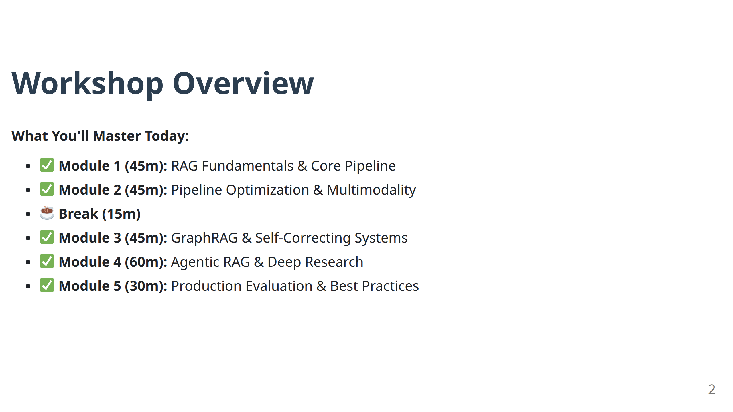

Slide 3
Module 1
RAG Fundamentals & The Core Pipeline

Slide 4
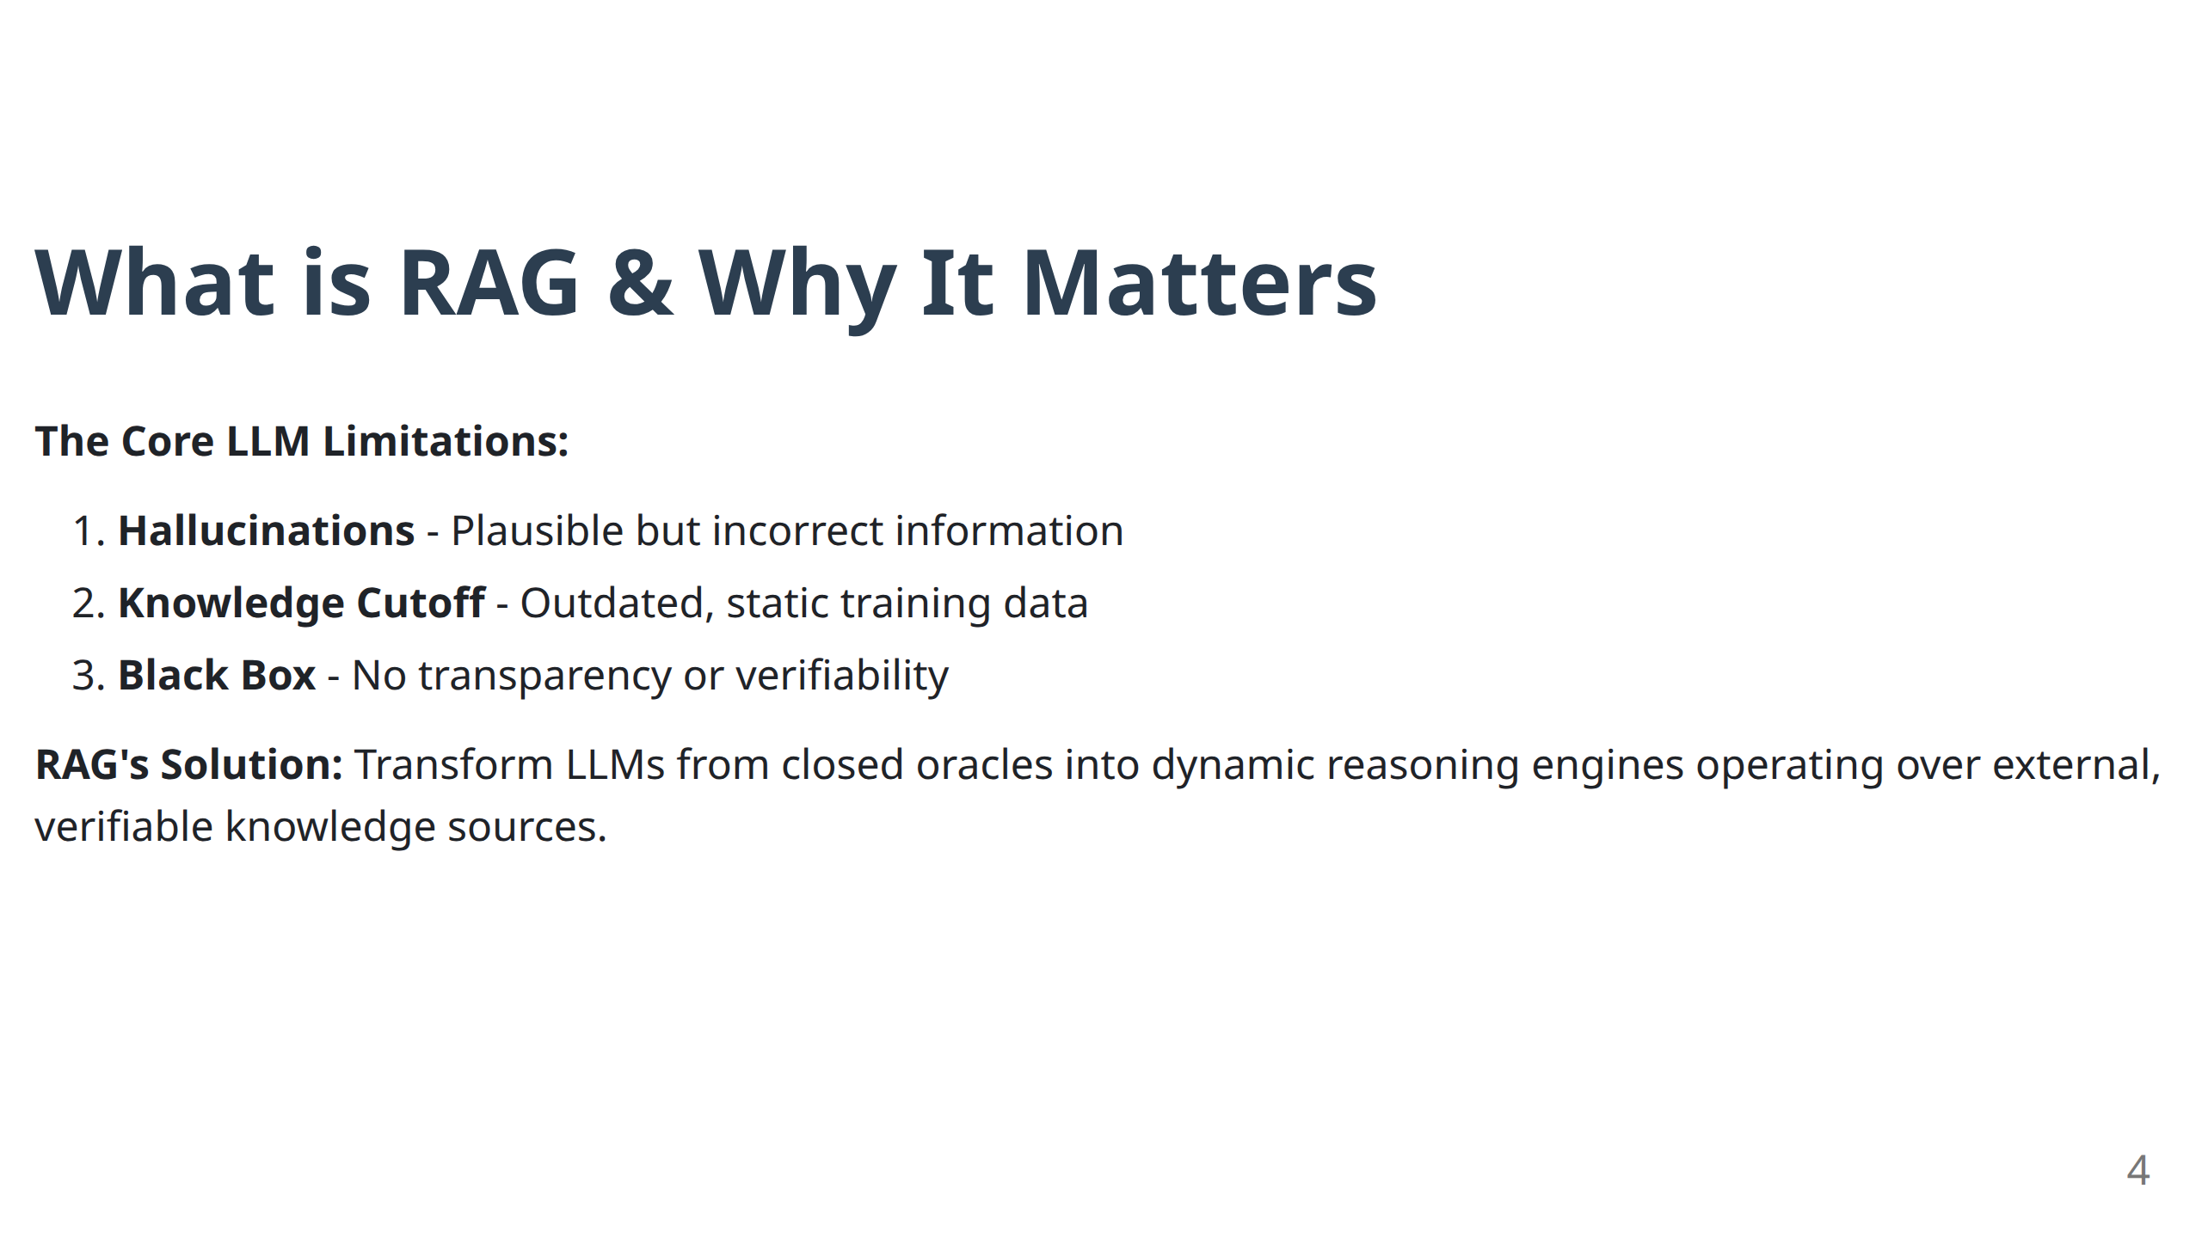
RAG addresses the hallucination problem in large language models but does not completely remove it. Instead, it shifts the challenge from hallucination to retrieval.

Slide 5
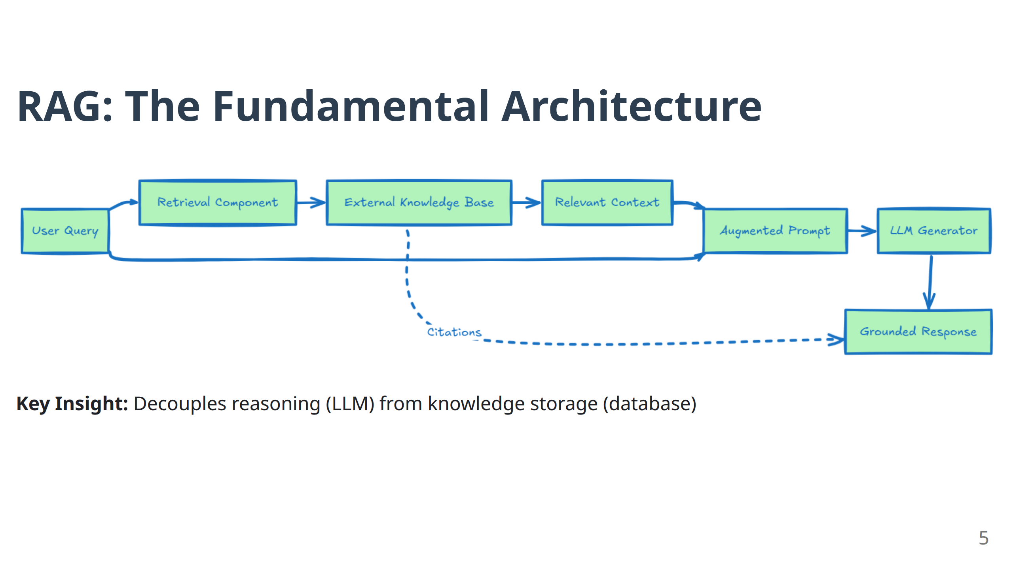

Slide 6
RAG vs Fine-Tuning: Distinct Roles
RAG: Knowledge Injection
Dynamic factual updates
No model retraining
20x more cost-effective
External, verifiable sources
Use for: What to know
Fine-Tuning: Behaviour Adaptation
Style, tone, vocabulary
Expensive retraining required
Adapts model parameters
Task-specific formats
Use for: How to respond
Best Practice: Build robust RAG pipeline first, fine-tune style later.
6

Slide 7
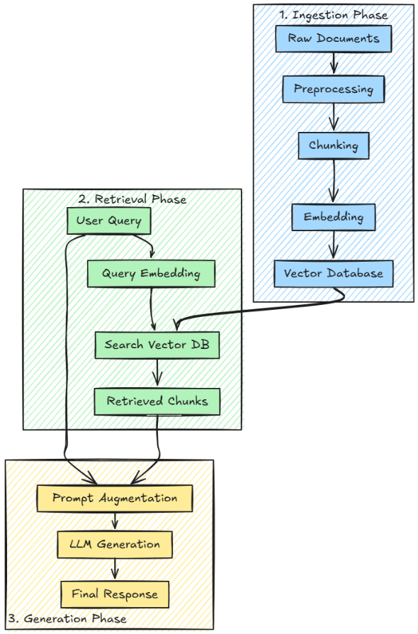
The Three-Phase RAG Pipeline
The RAG pipeline consists of three consecutive stages:
ingestion, which includes data loading, preprocessing, chunking, embedding, and indexing;
retrieval, where the system queries the vector database according to user input;
generation, which uses the retrieved chunks to produce contextually appropriate responses.
7

Slide 8
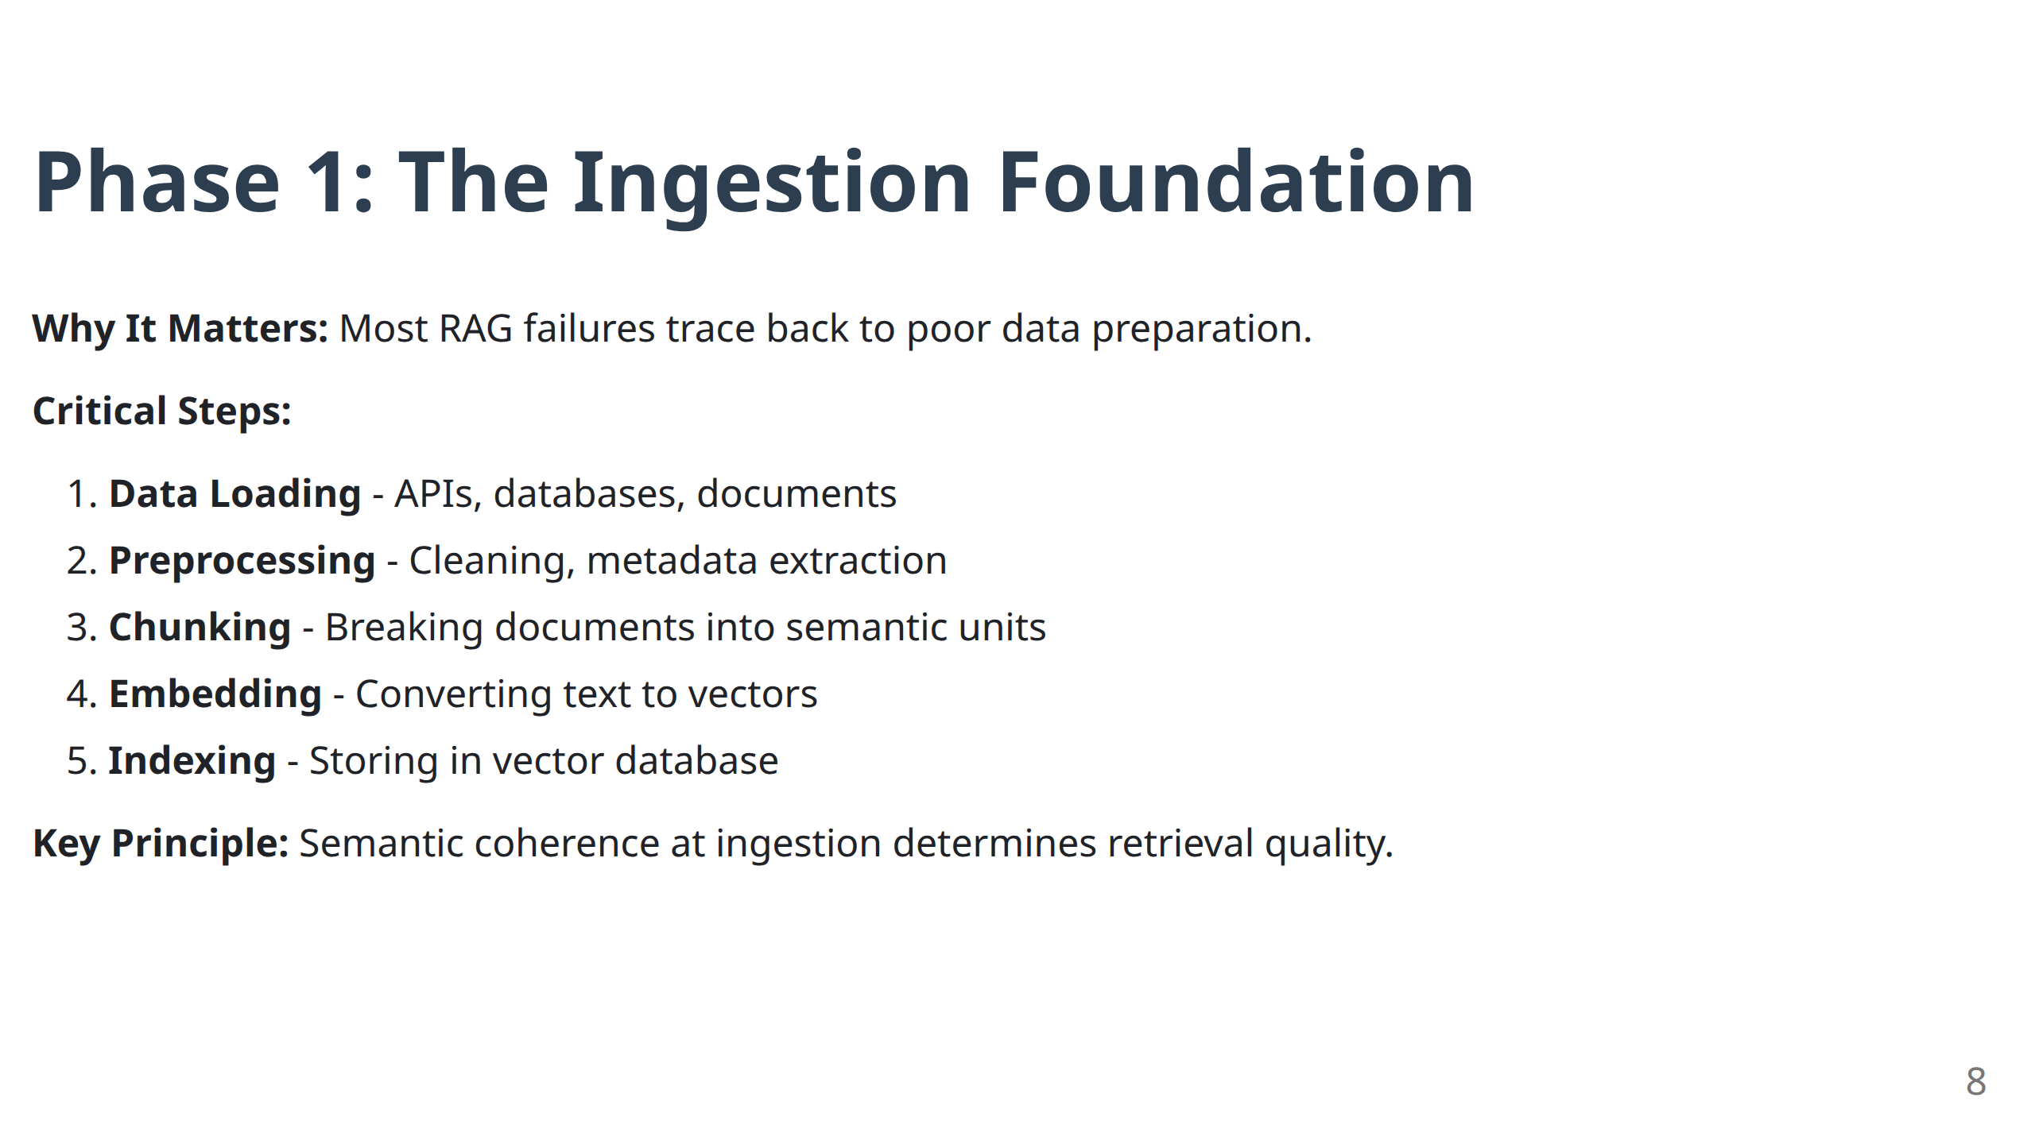

Slide 9
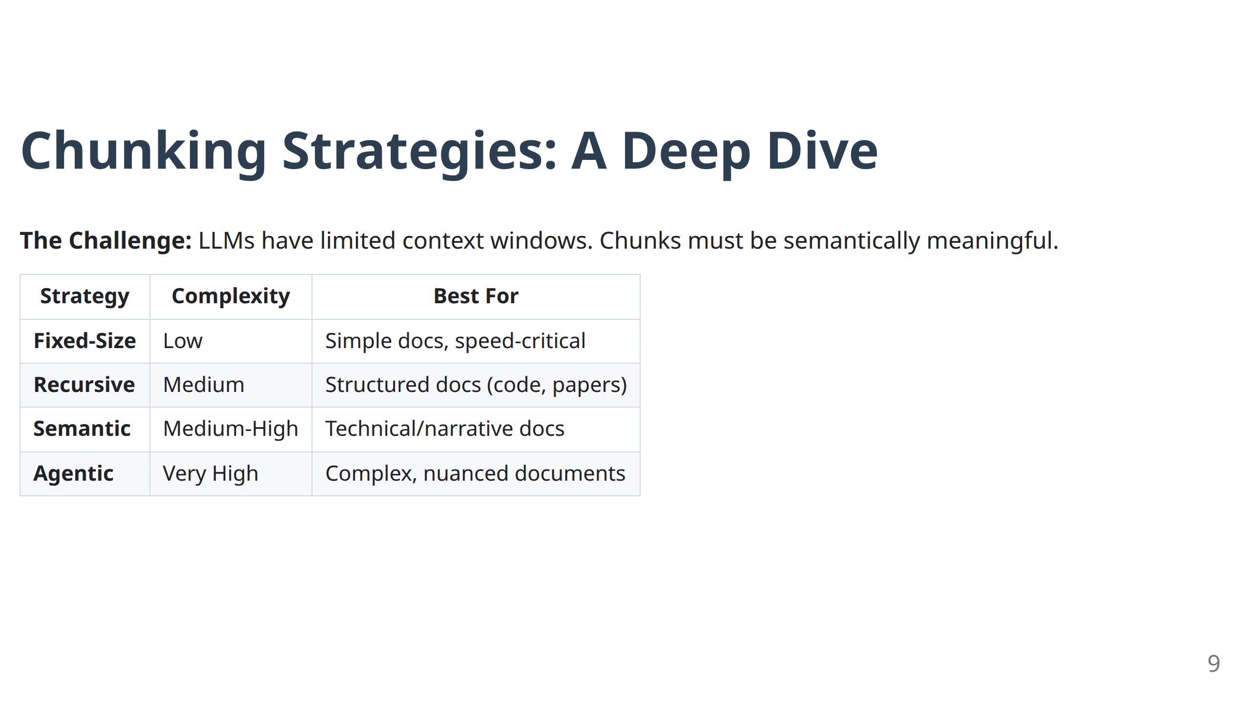

Slide 10
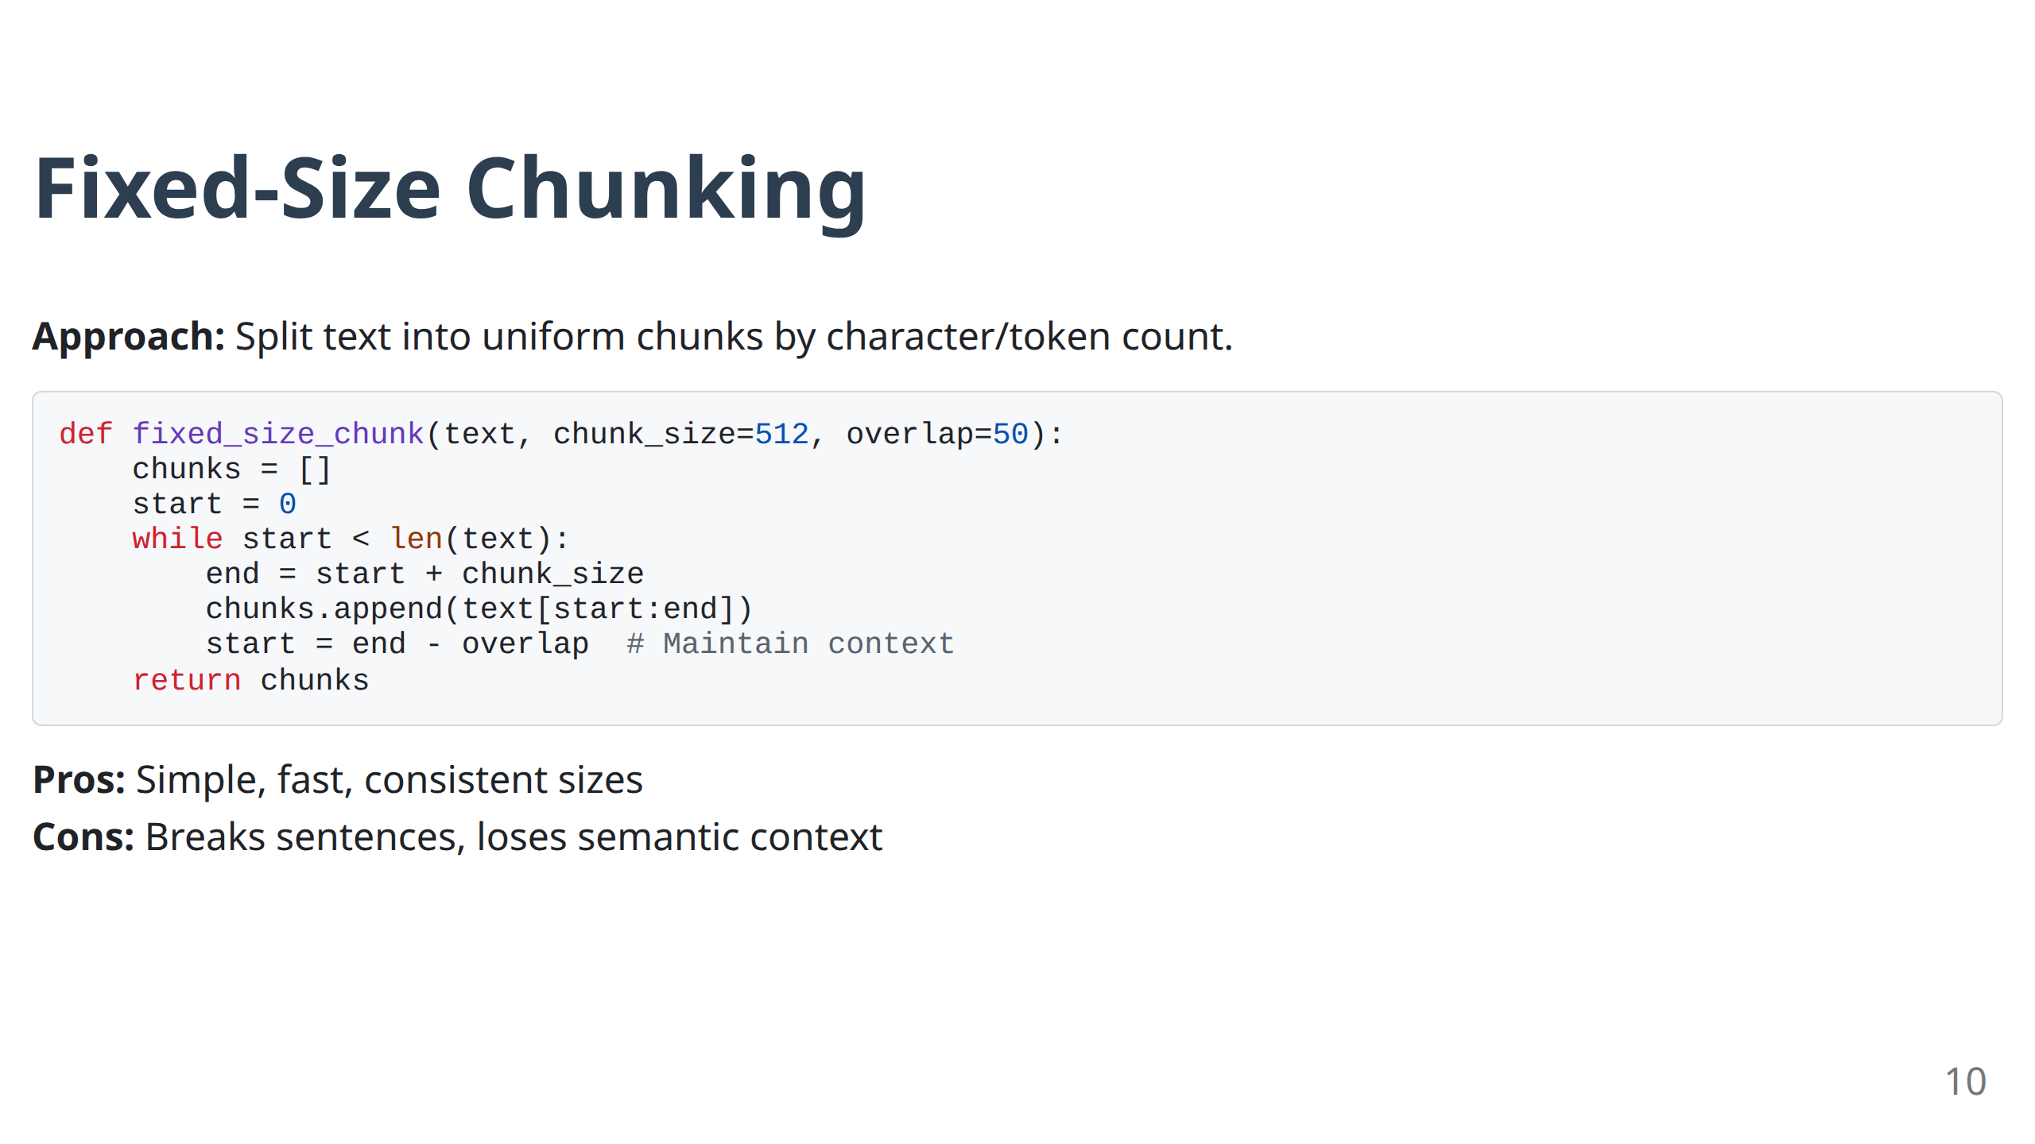

Slide 11
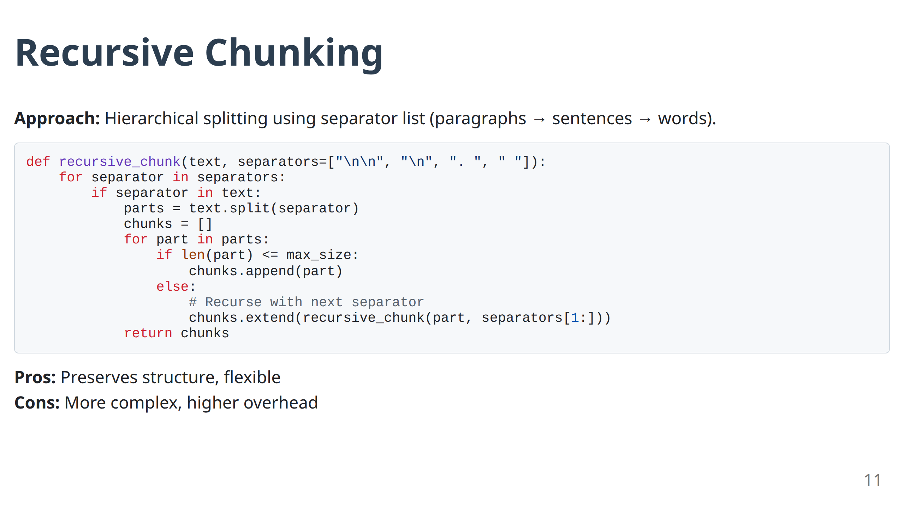

Slide 12
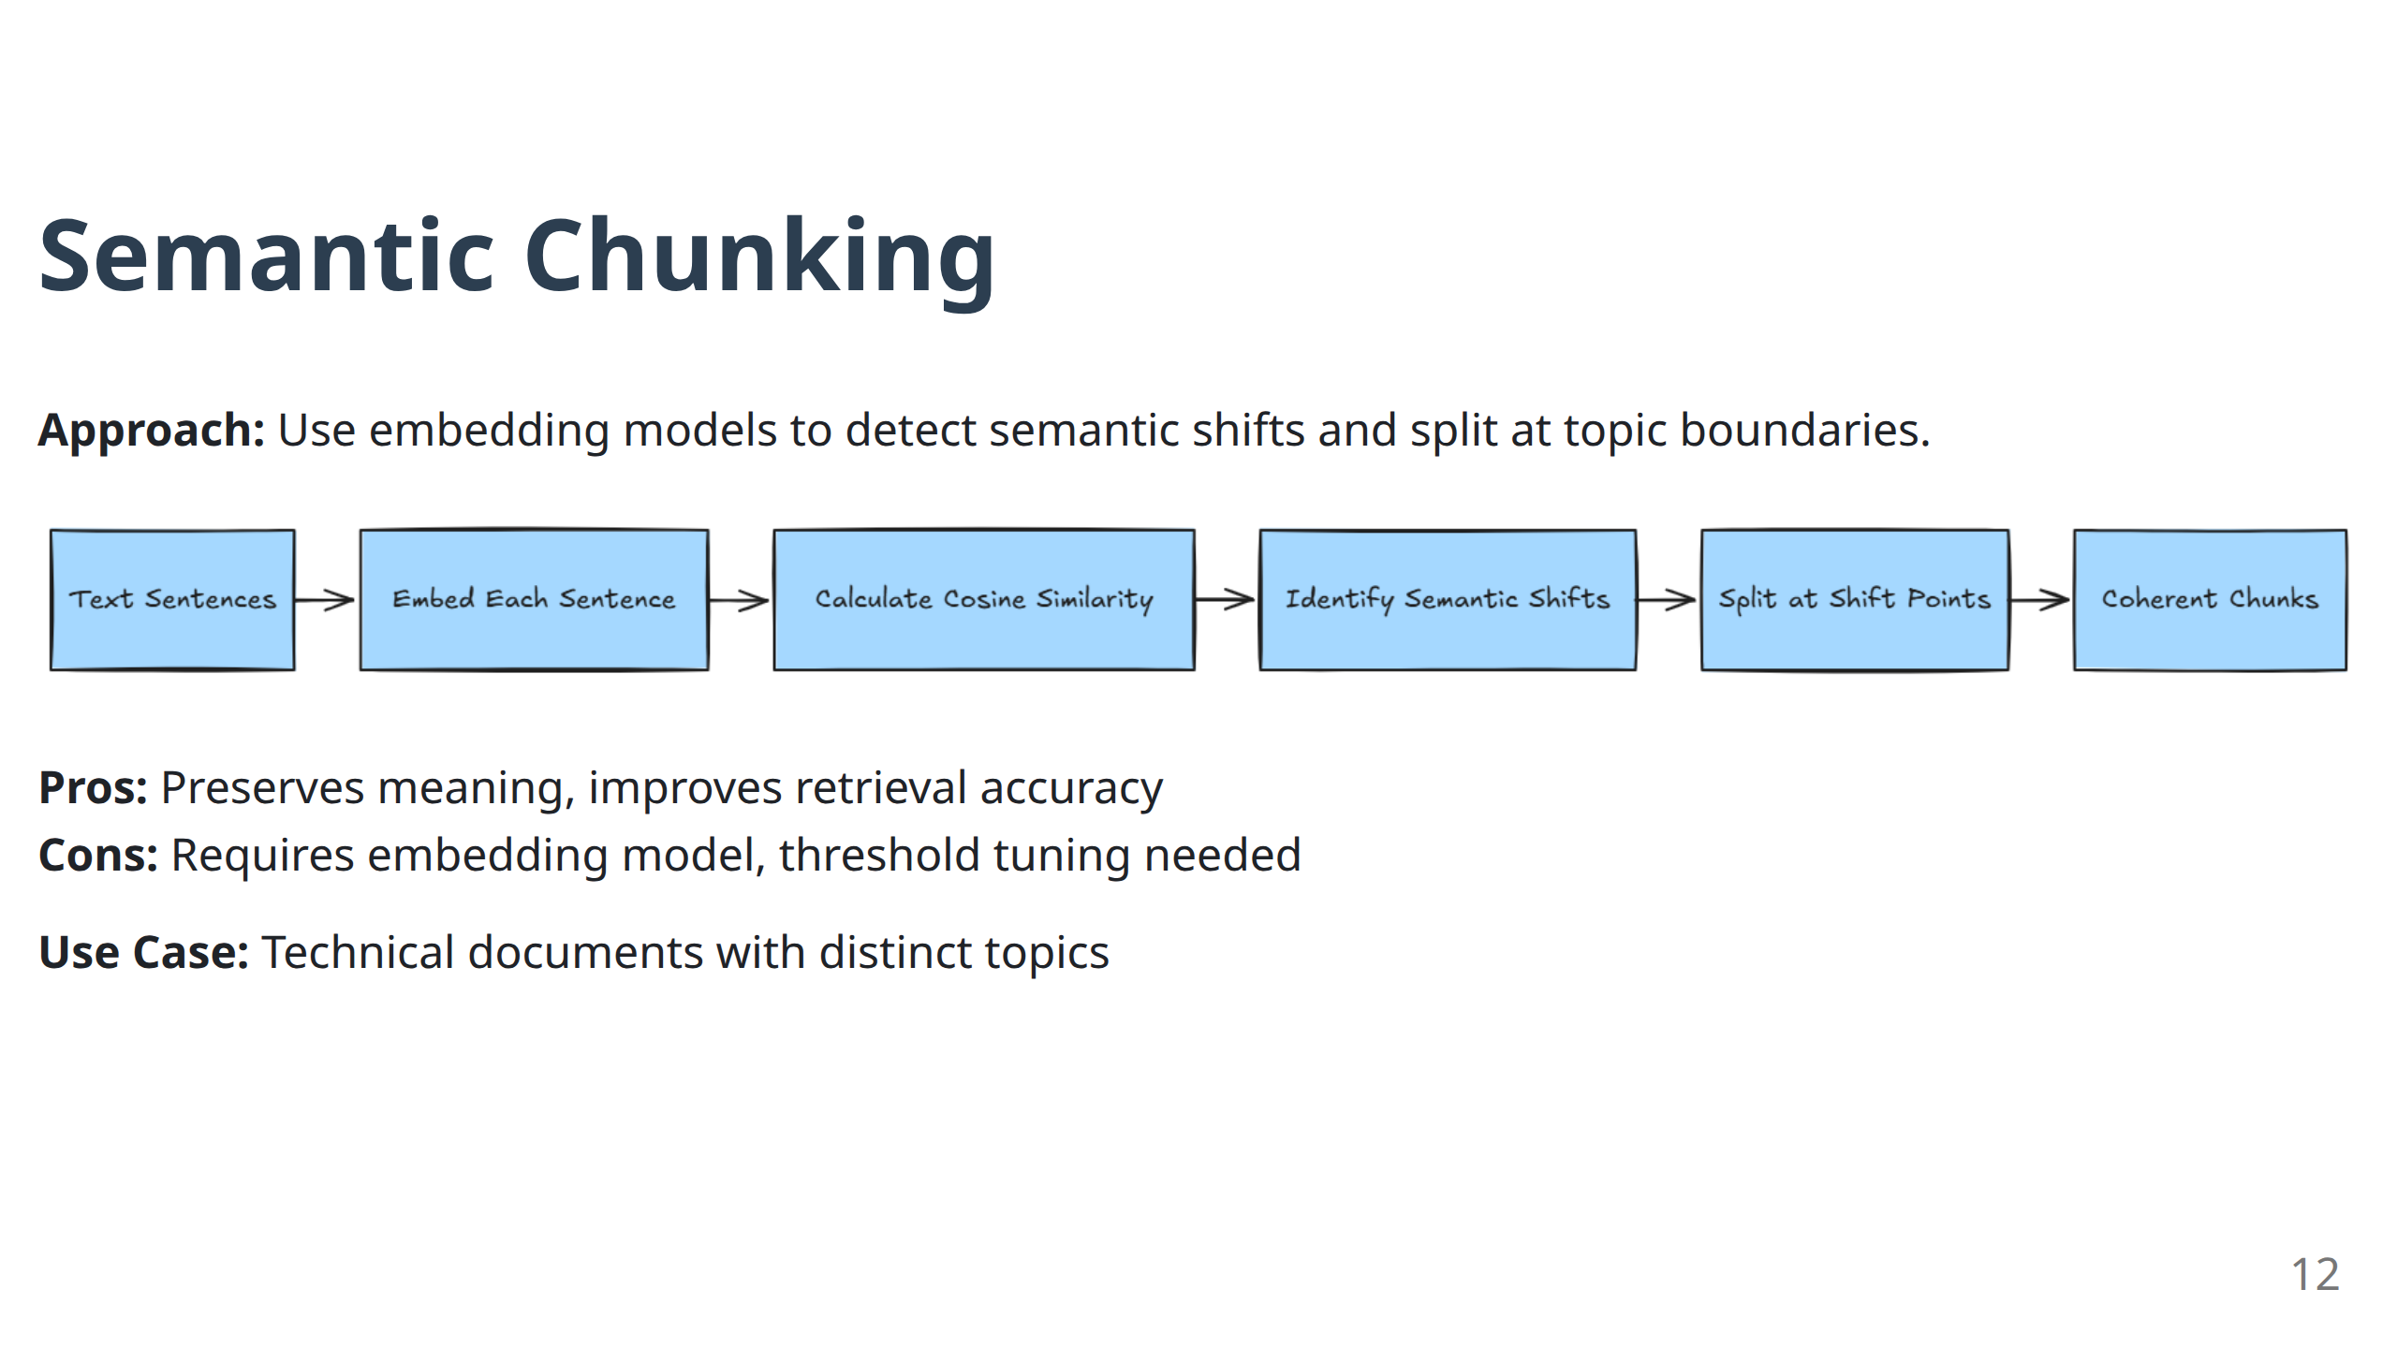

Slide 13
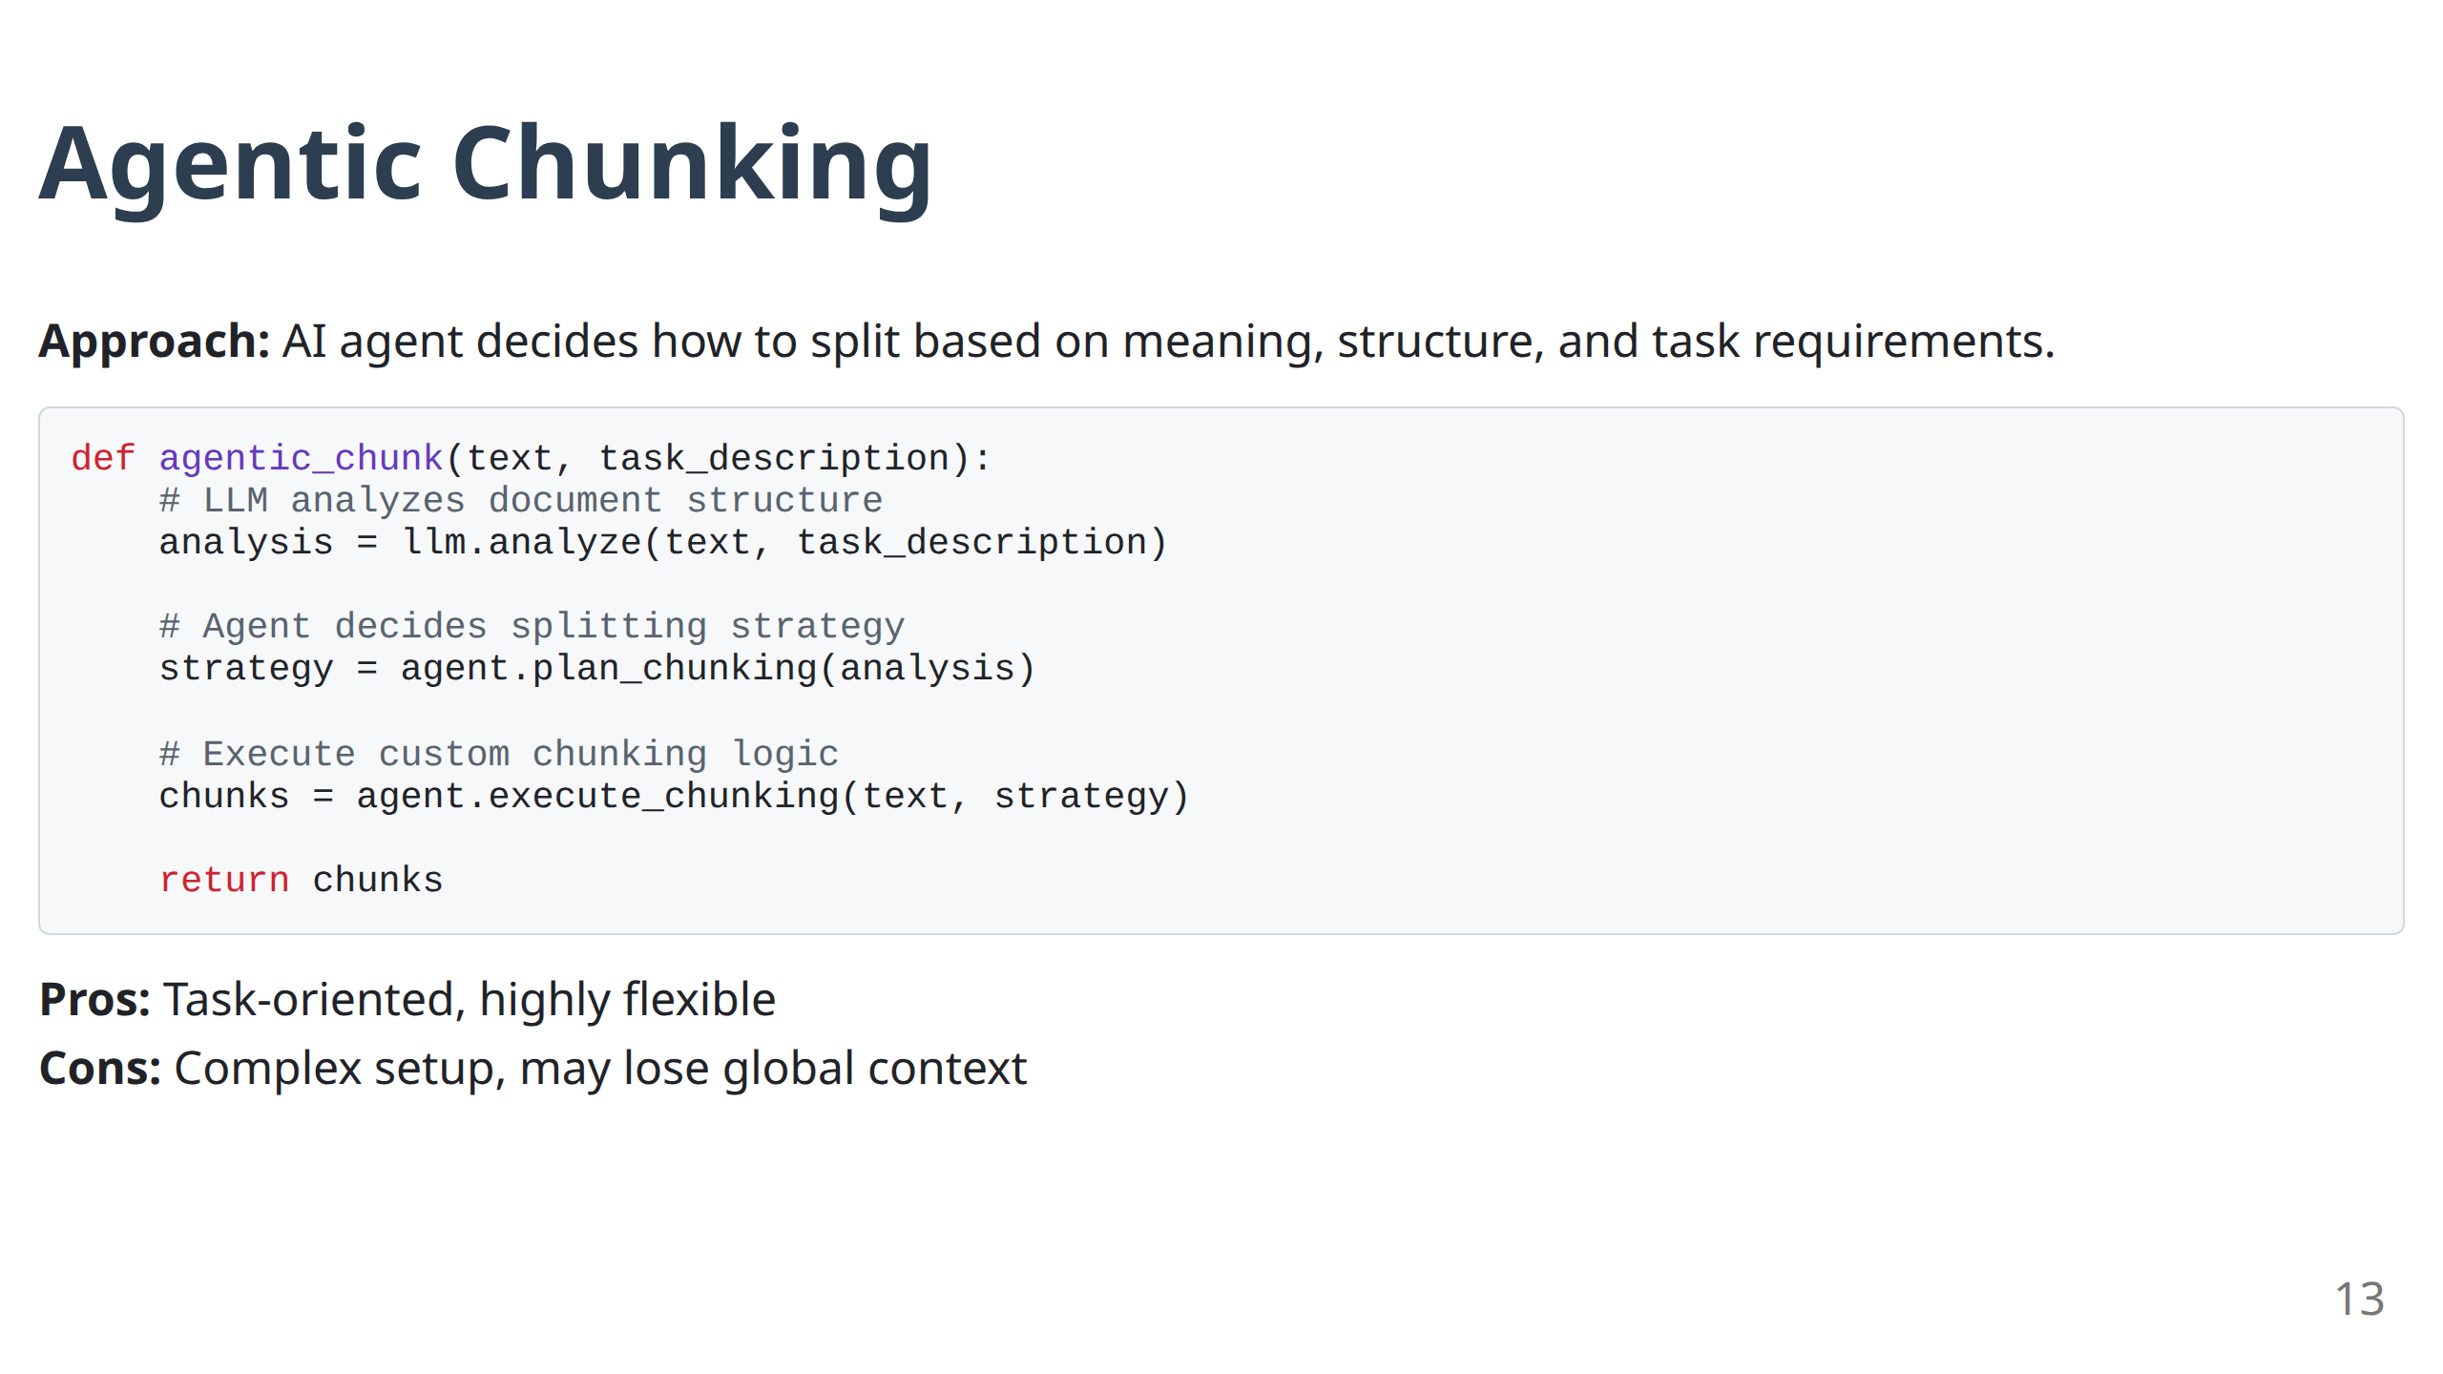

Slide 14
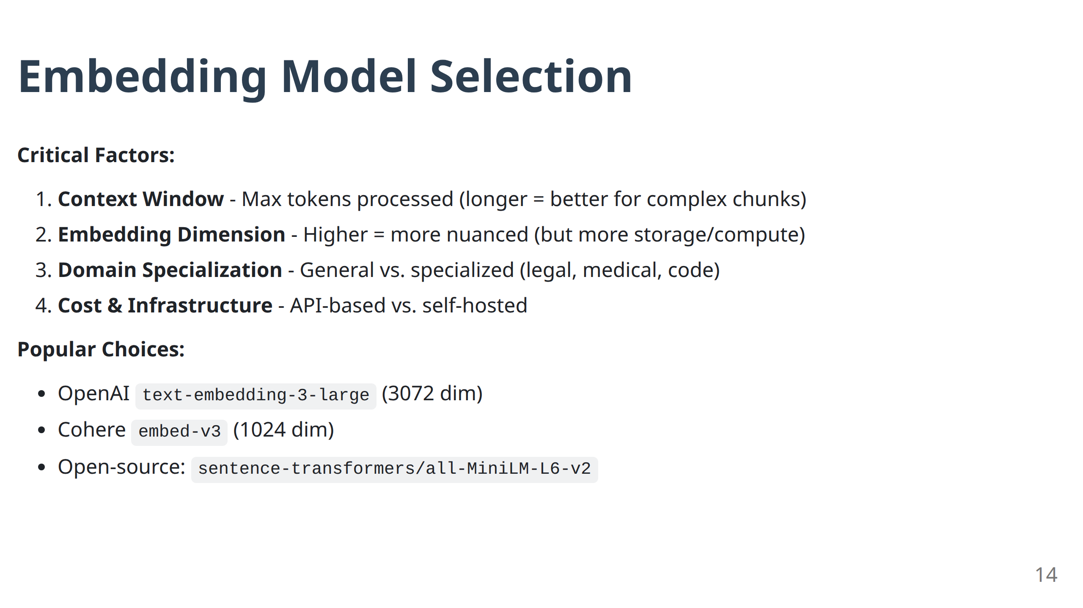

Slide 15
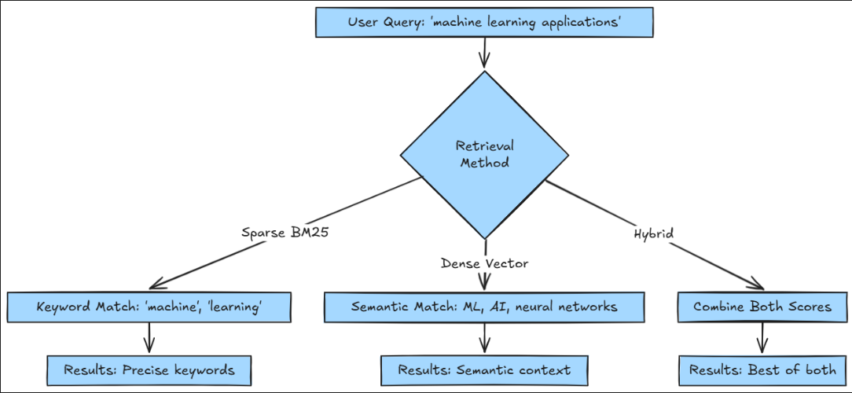
Phase 2: Retrieval Methods Compared
The Evolution: Sparse → Dense → Hybrid
15

Slide 16
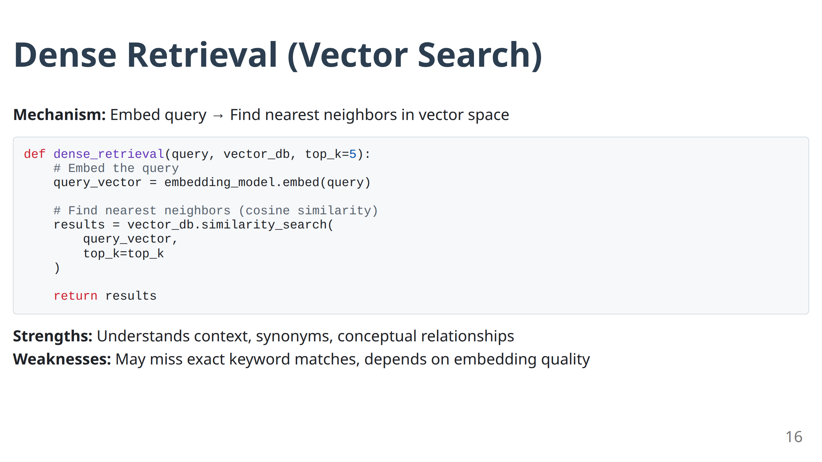

Slide 17
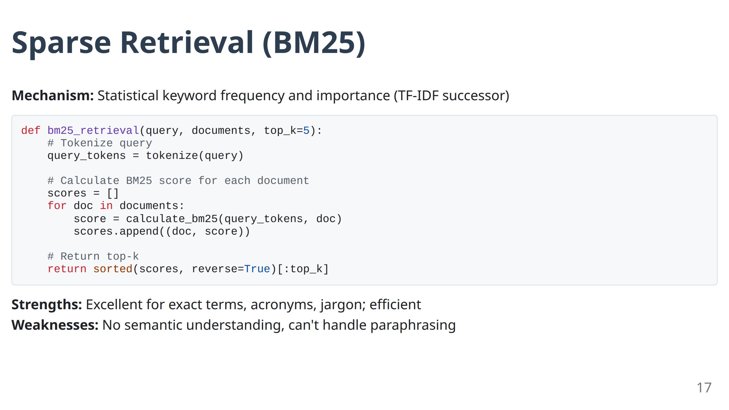

Slide 18
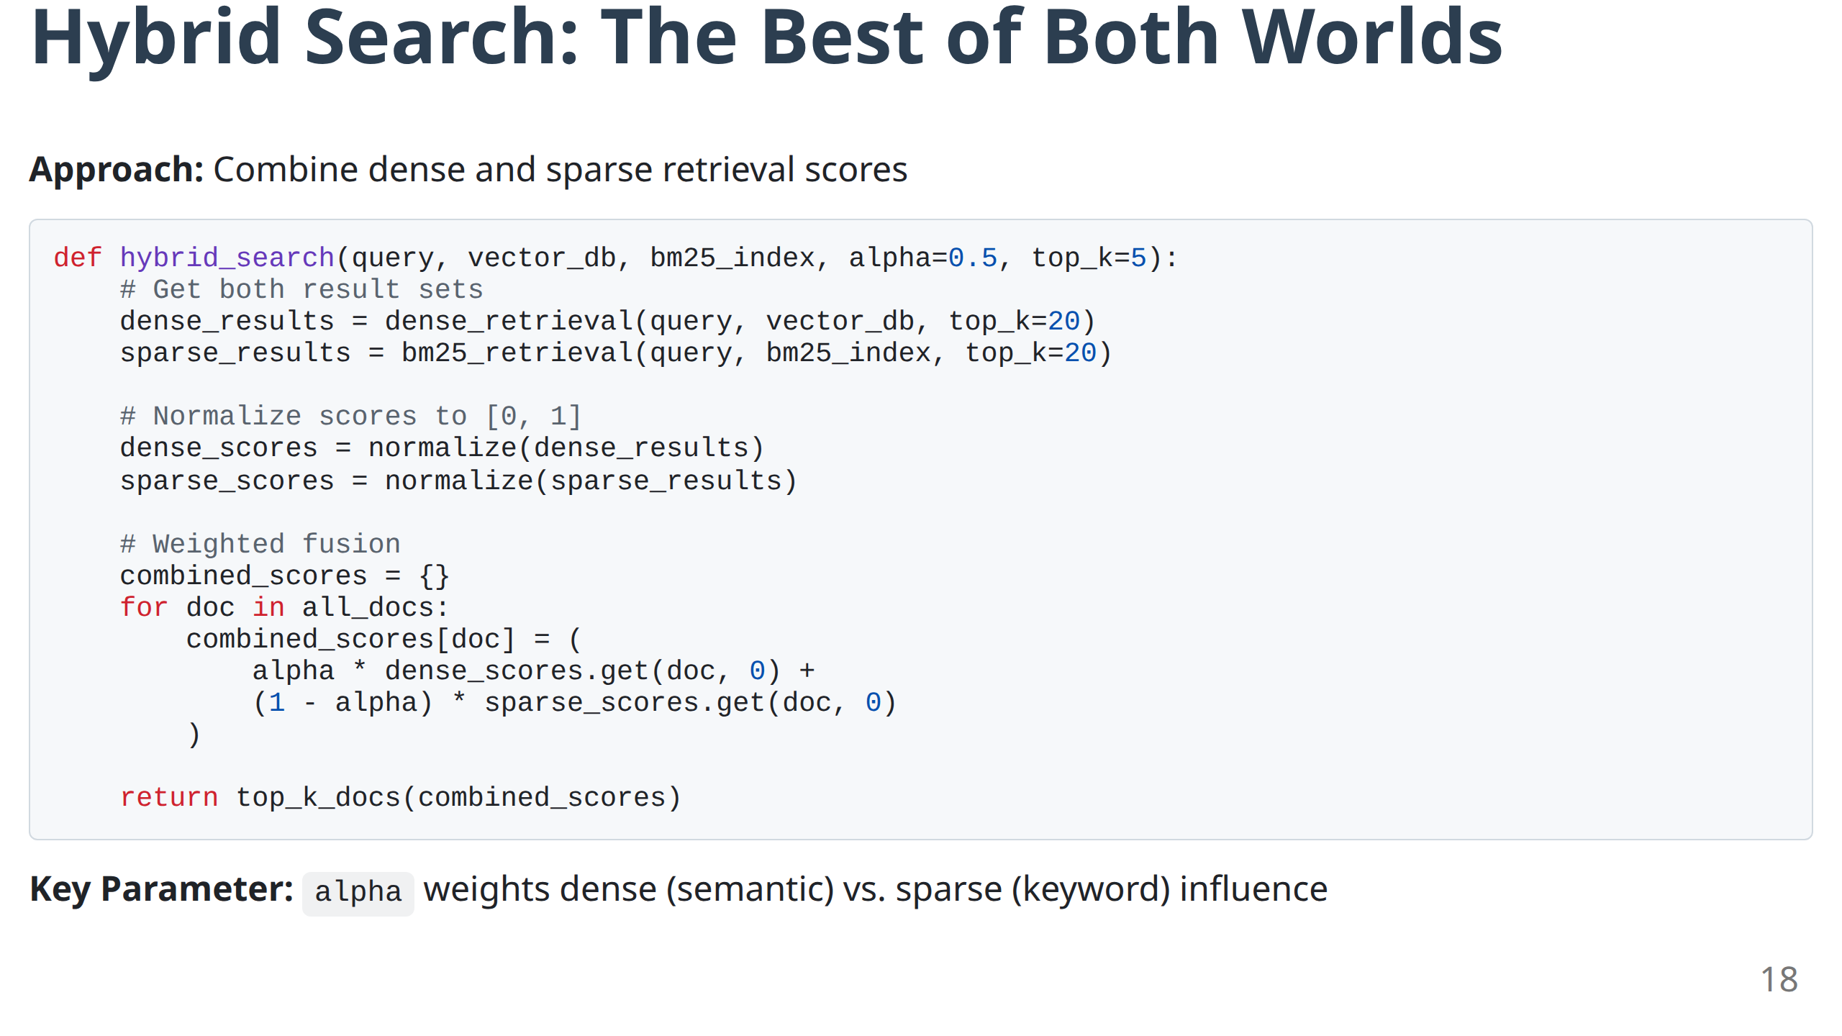

Slide 19
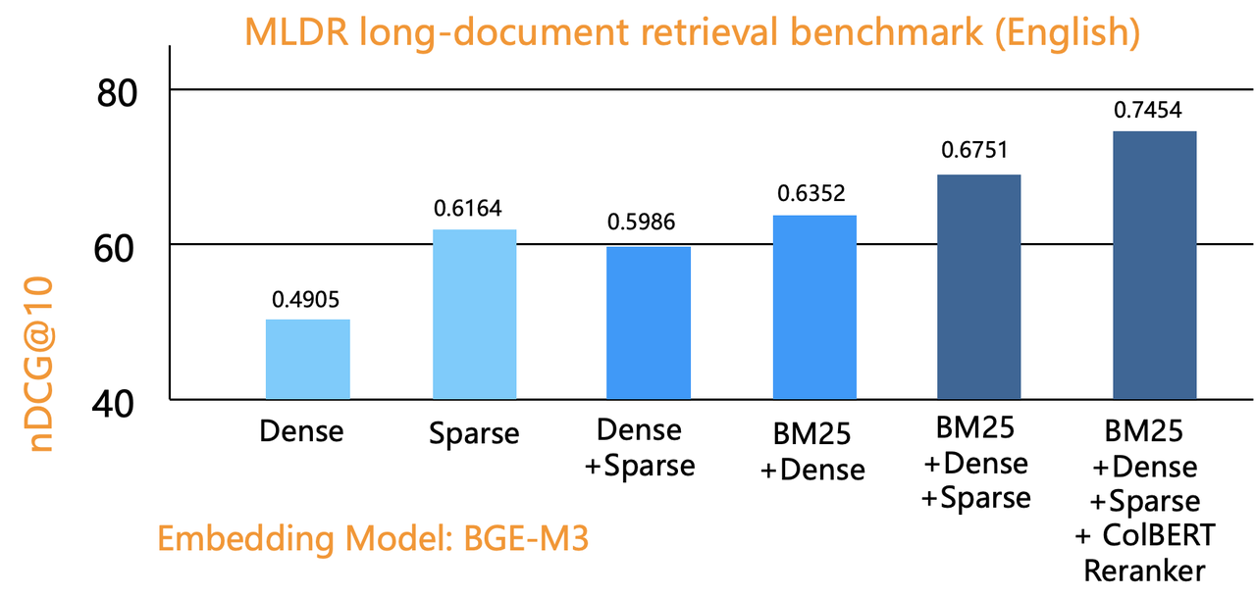
Hybrid Search: Performance Comparison
Source: https://infiniflow.org/blog/best-hybrid-search-solution
Empirical Finding: Hybrid consistently outperforms single methods across diverse query types.
Production Recommendation: Start with 50/50 weighting (α=0.5), then tune based on your domain.
19

Slide 20
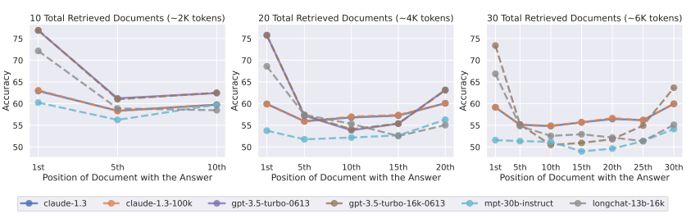
Phase 3: Generation & The "Lost in the Middle" Problem
Challenge: LLMs exhibit attentional bias - prioritize information at prompt edges.
Source: Lost in the Middle: How Language Models Use Long Contexts | Image: Nelson F. Liu et al.
Implication: Retrieved chunk order matters. Most critical information should be placed at beginning and end of context.
Solution Preview: Post-retrieval re-ranking (Module 2)
20

Slide 21
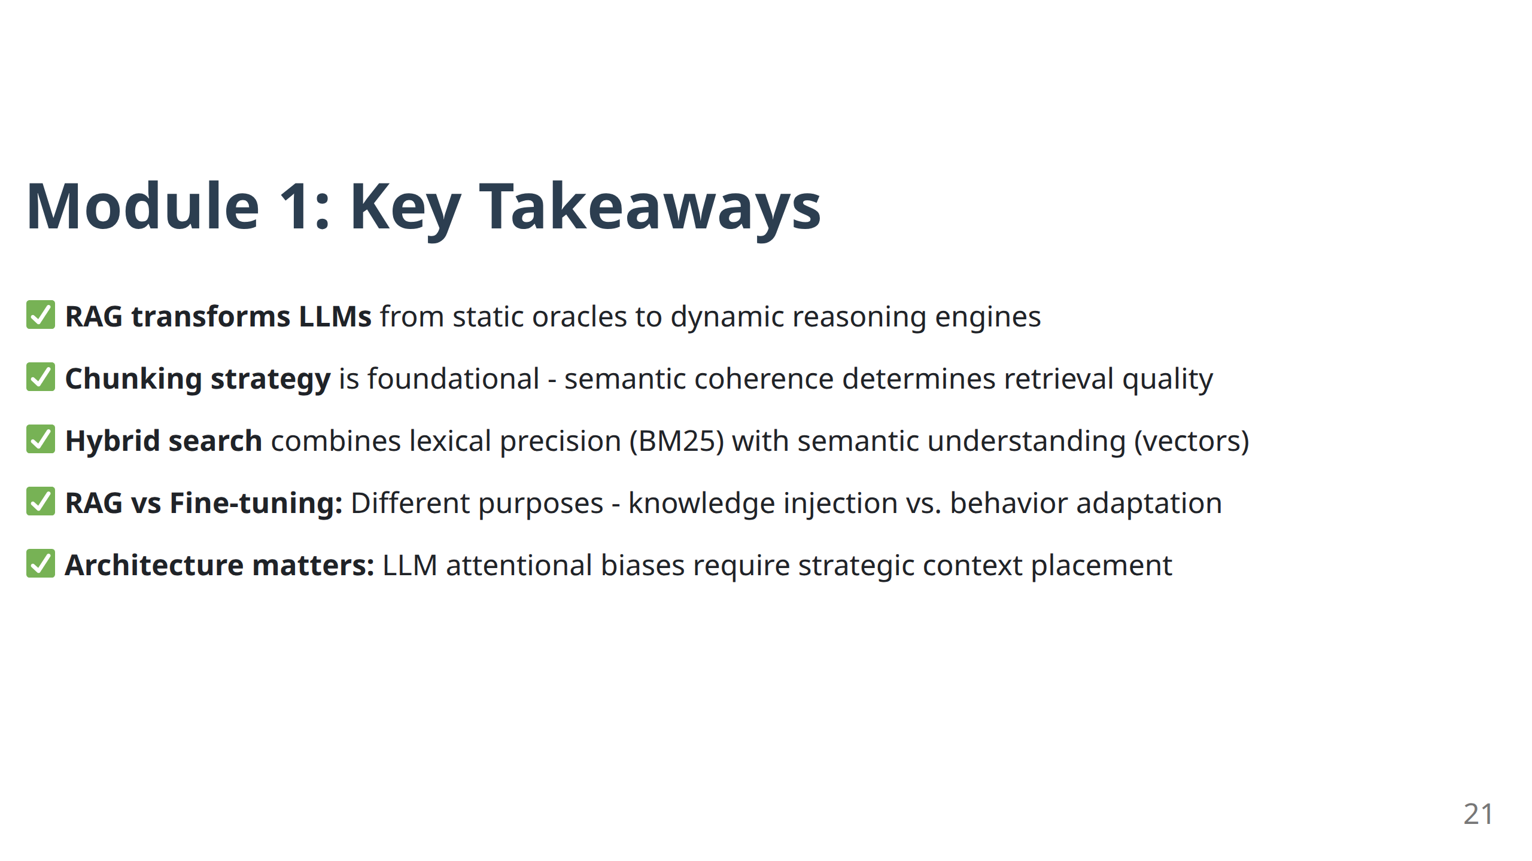

Slide 22
Module 2
Optimizing the Pipeline & Handling Multimodality

Slide 23
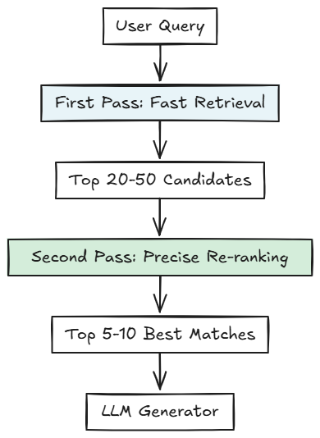
Post-Retrieval Optimization: The Two-Pass Pattern
Architecture: Recall-then-Precision Funnel
Trade-off: Speed (first pass) vs. Accuracy (second pass)
23

Slide 24
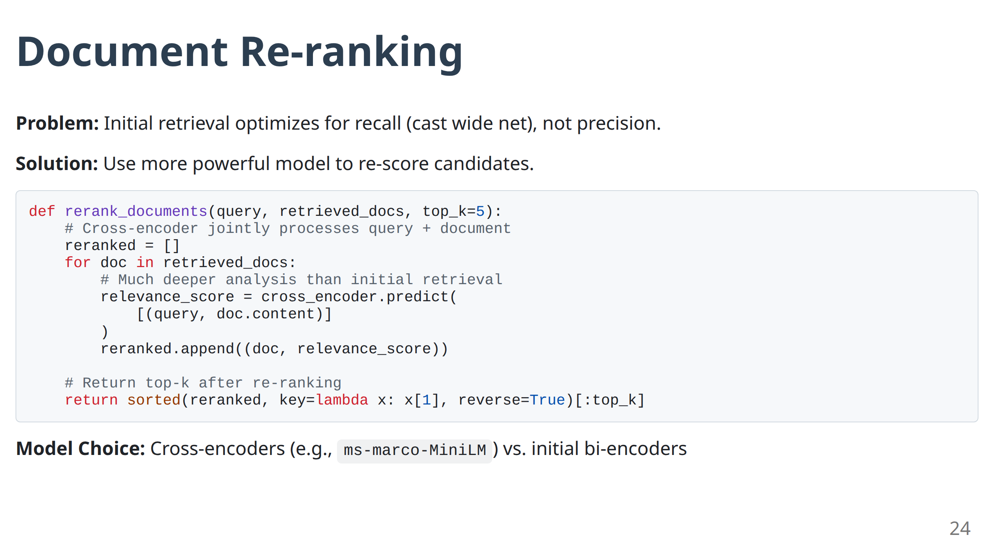

Slide 25
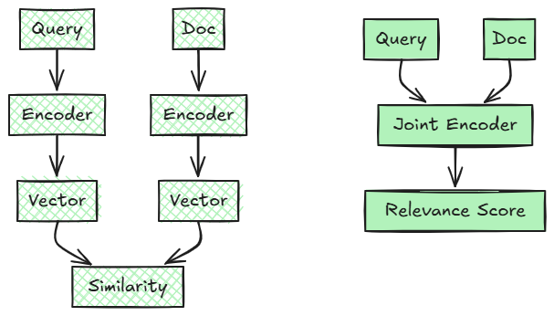
Re-ranking: Bi-Encoder vs Cross-Encoder
Bi-Encoder (Initial Retrieval)
Cross-Encoder (Re-ranking)
Trade-off: Bi-encoder is fast but less accurate; Cross-encoder is slow but highly accurate.
25

Slide 26
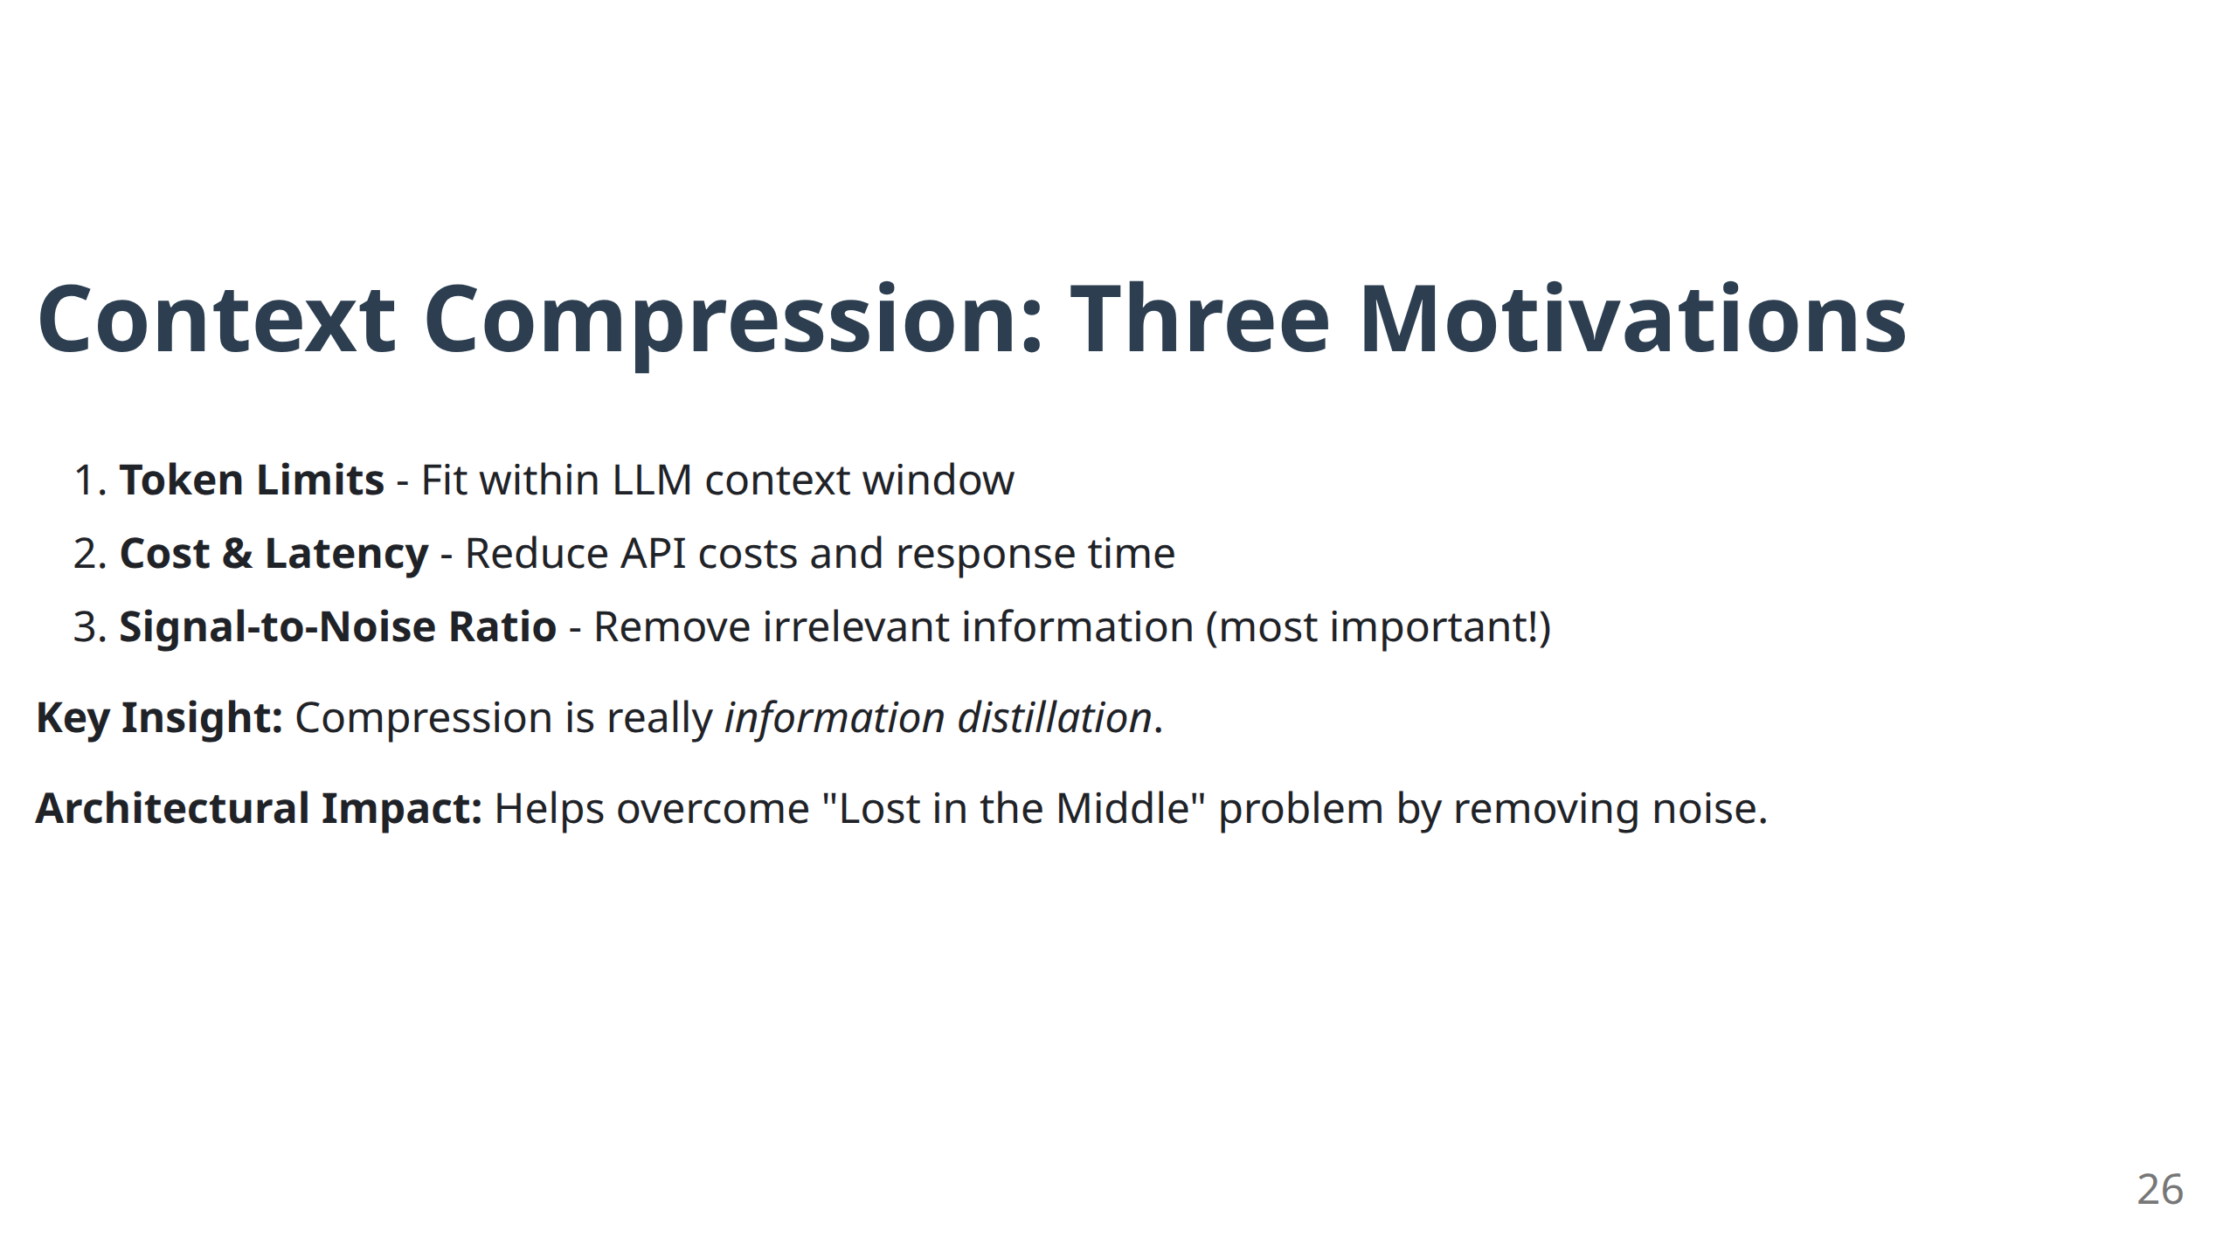

Slide 27
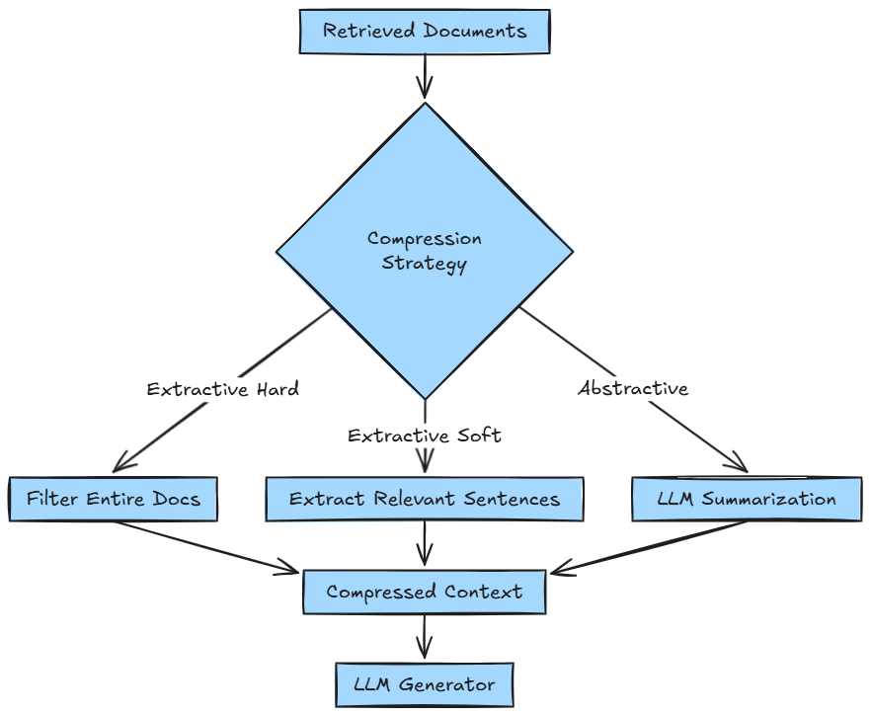
Context Compression Techniques
Choice Factors: Quality requirements, latency tolerance, cost constraints
27

Slide 28
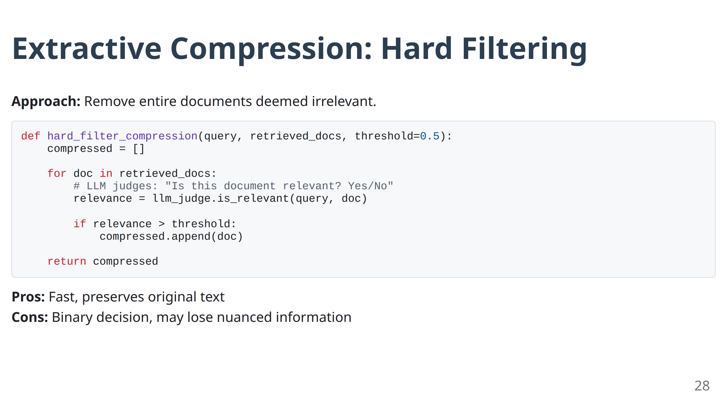

Slide 29
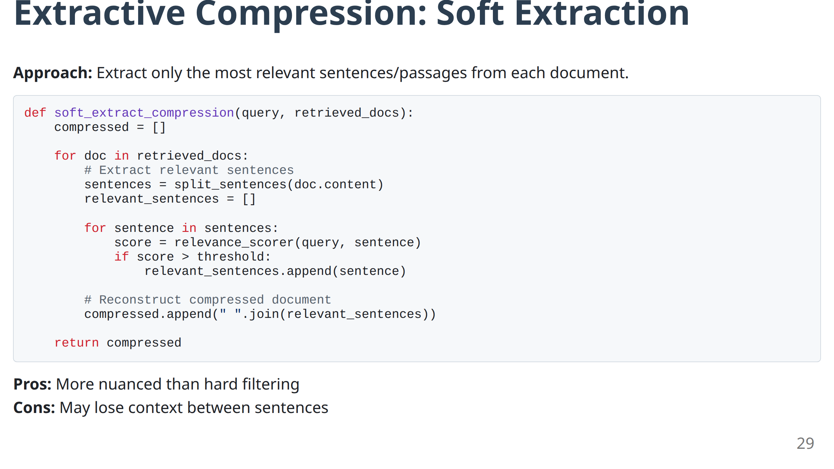

Slide 30
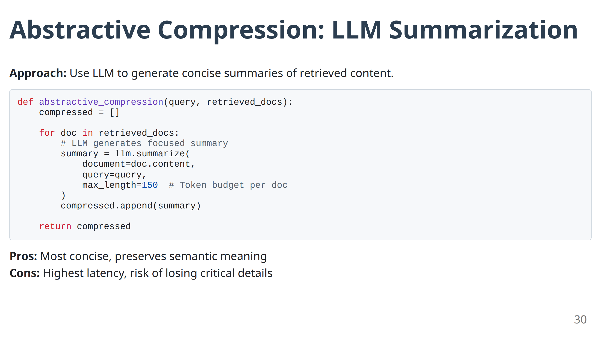

Slide 31
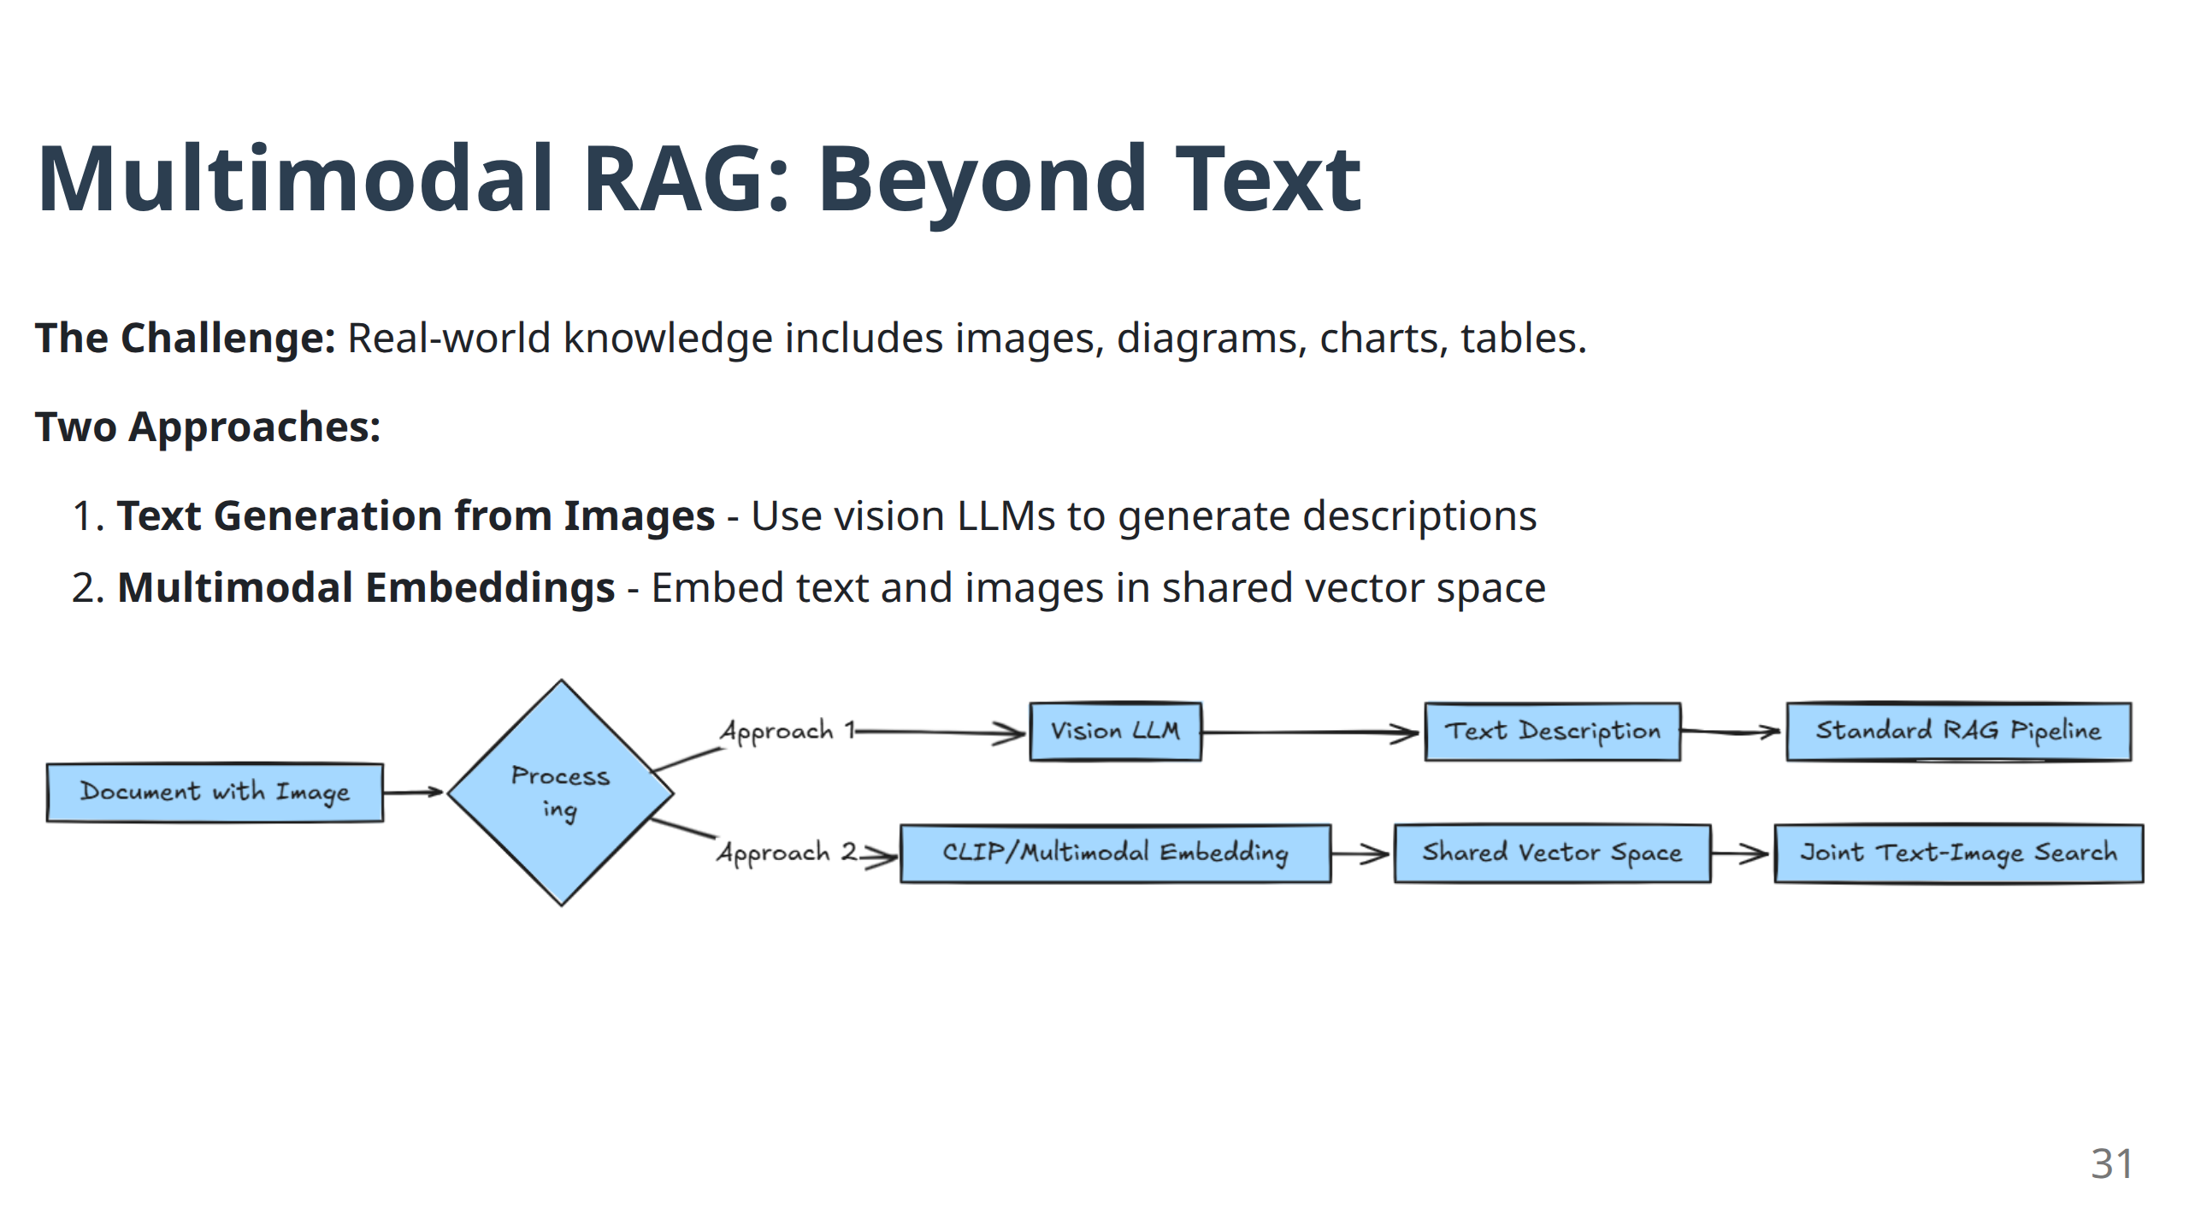

Slide 32
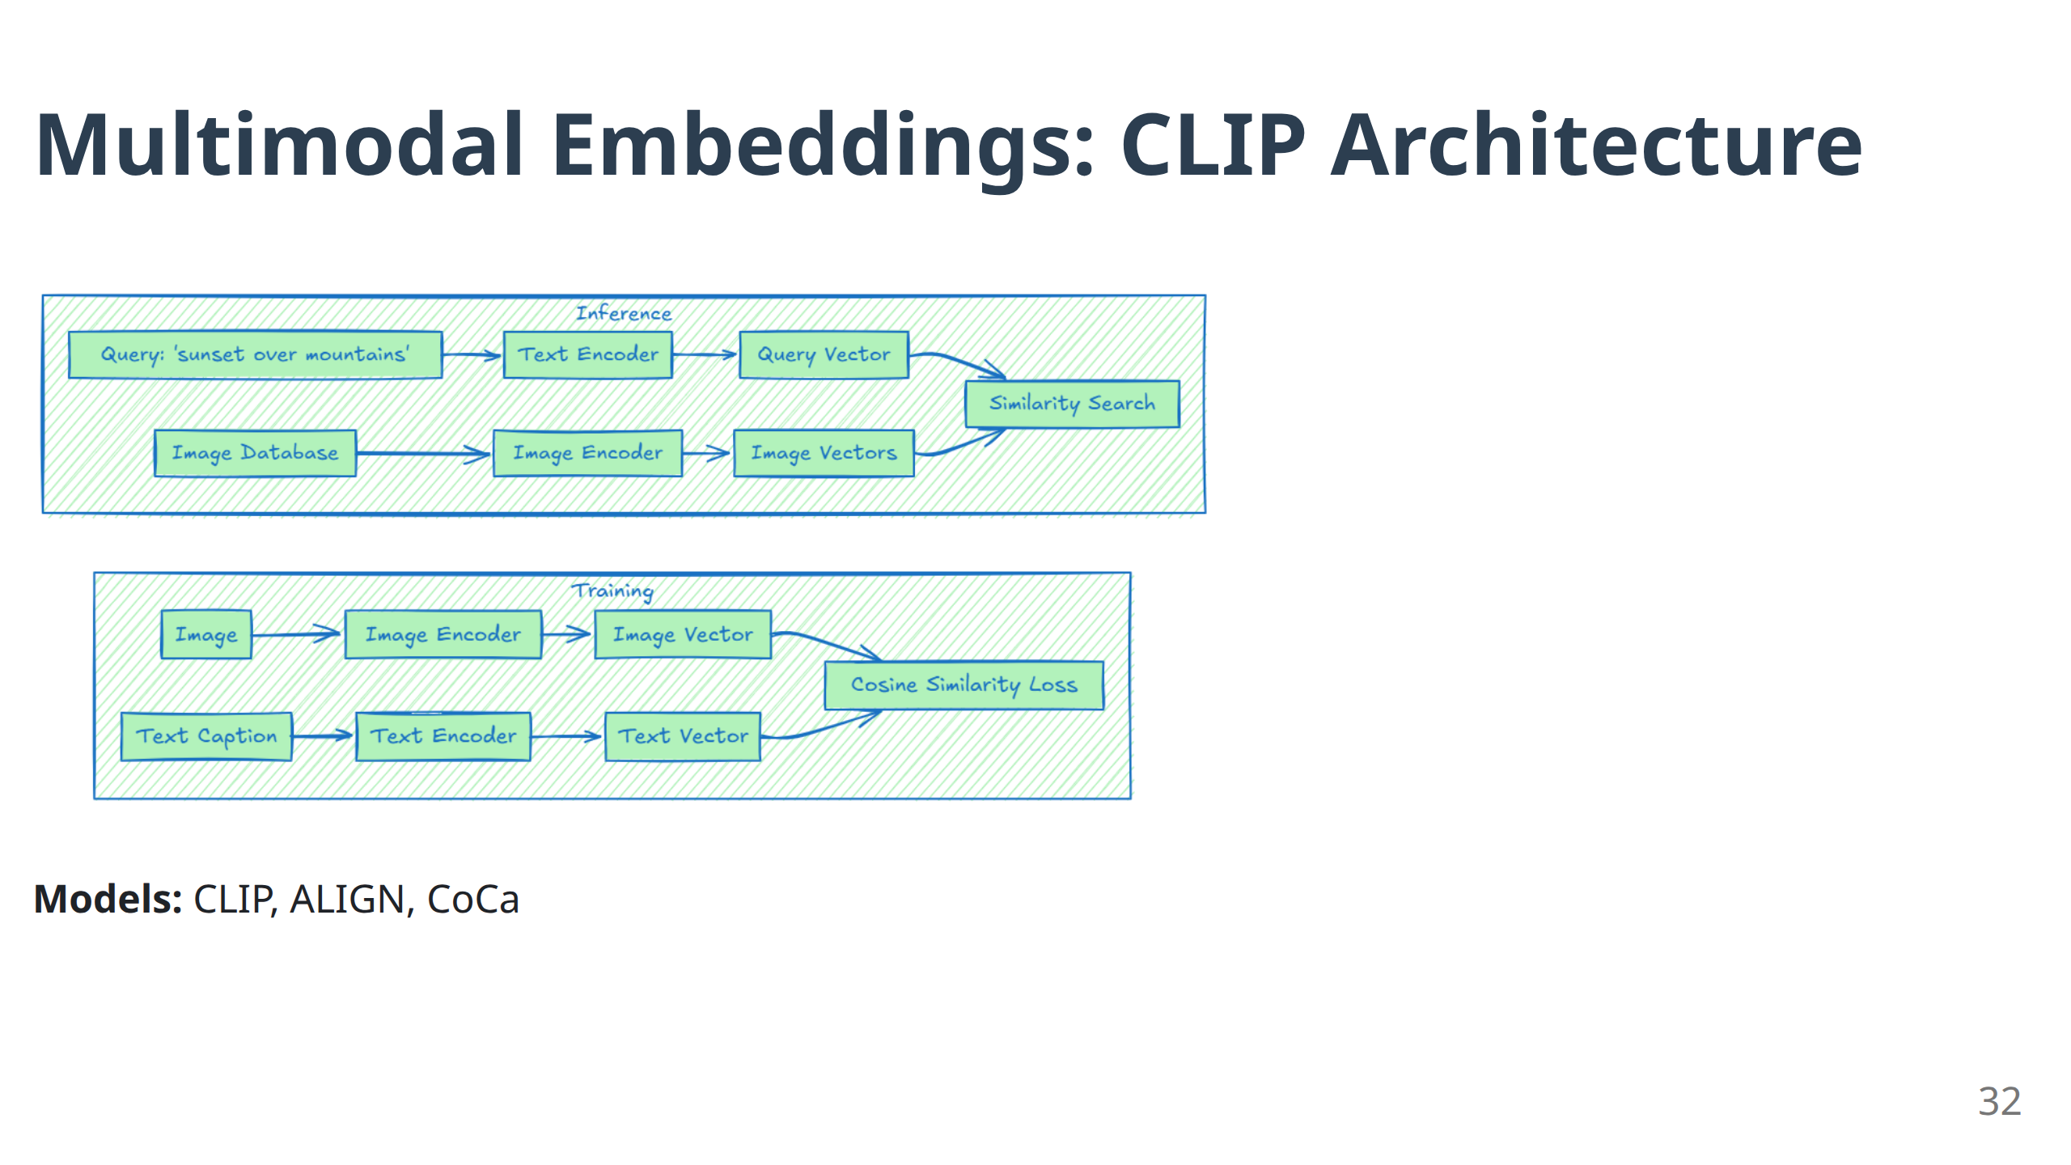

Slide 33
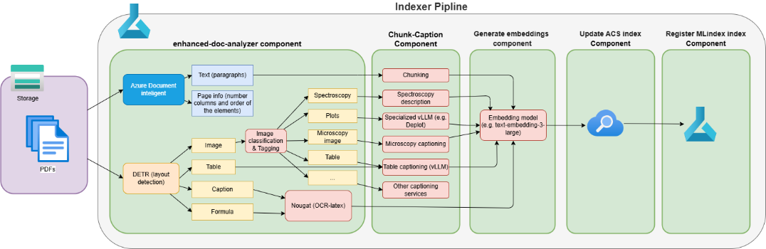
A real-life example:
Applicability of specialized GenAI models:
Layout detection (Meta’s DETR-based Aryn/deformable-detr-DocLayNet, trained on DocLayNet (including 80K annotated scientific article pages))
OCR and LaTeX formula extraction from documents (Meta’s Nougat)
Image captioning per image category:
Converting the plot images to linearized tables (DePlot) for improved visual language reasoning
Domain adapted LLM e.g. ChemVLM for Chemical molecules and reactions
Additional fine-tuning

Slide 34
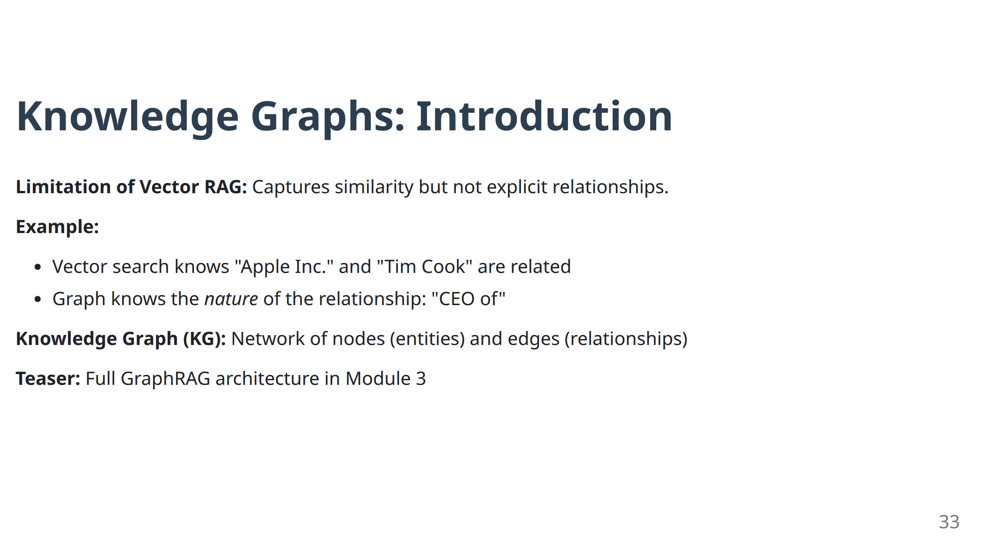

Slide 35
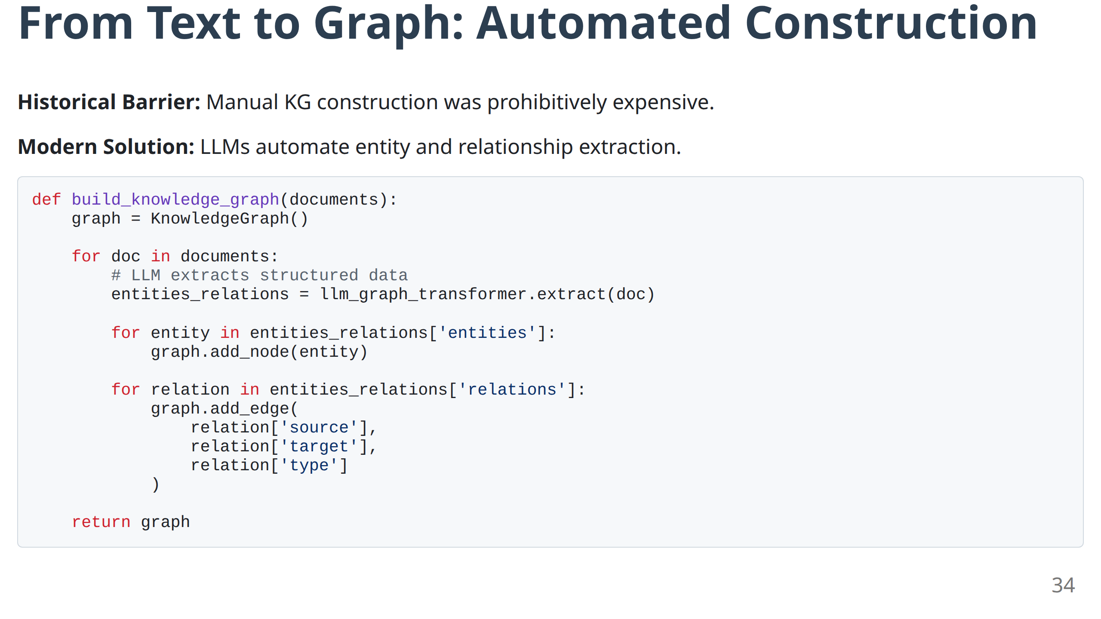

Slide 36
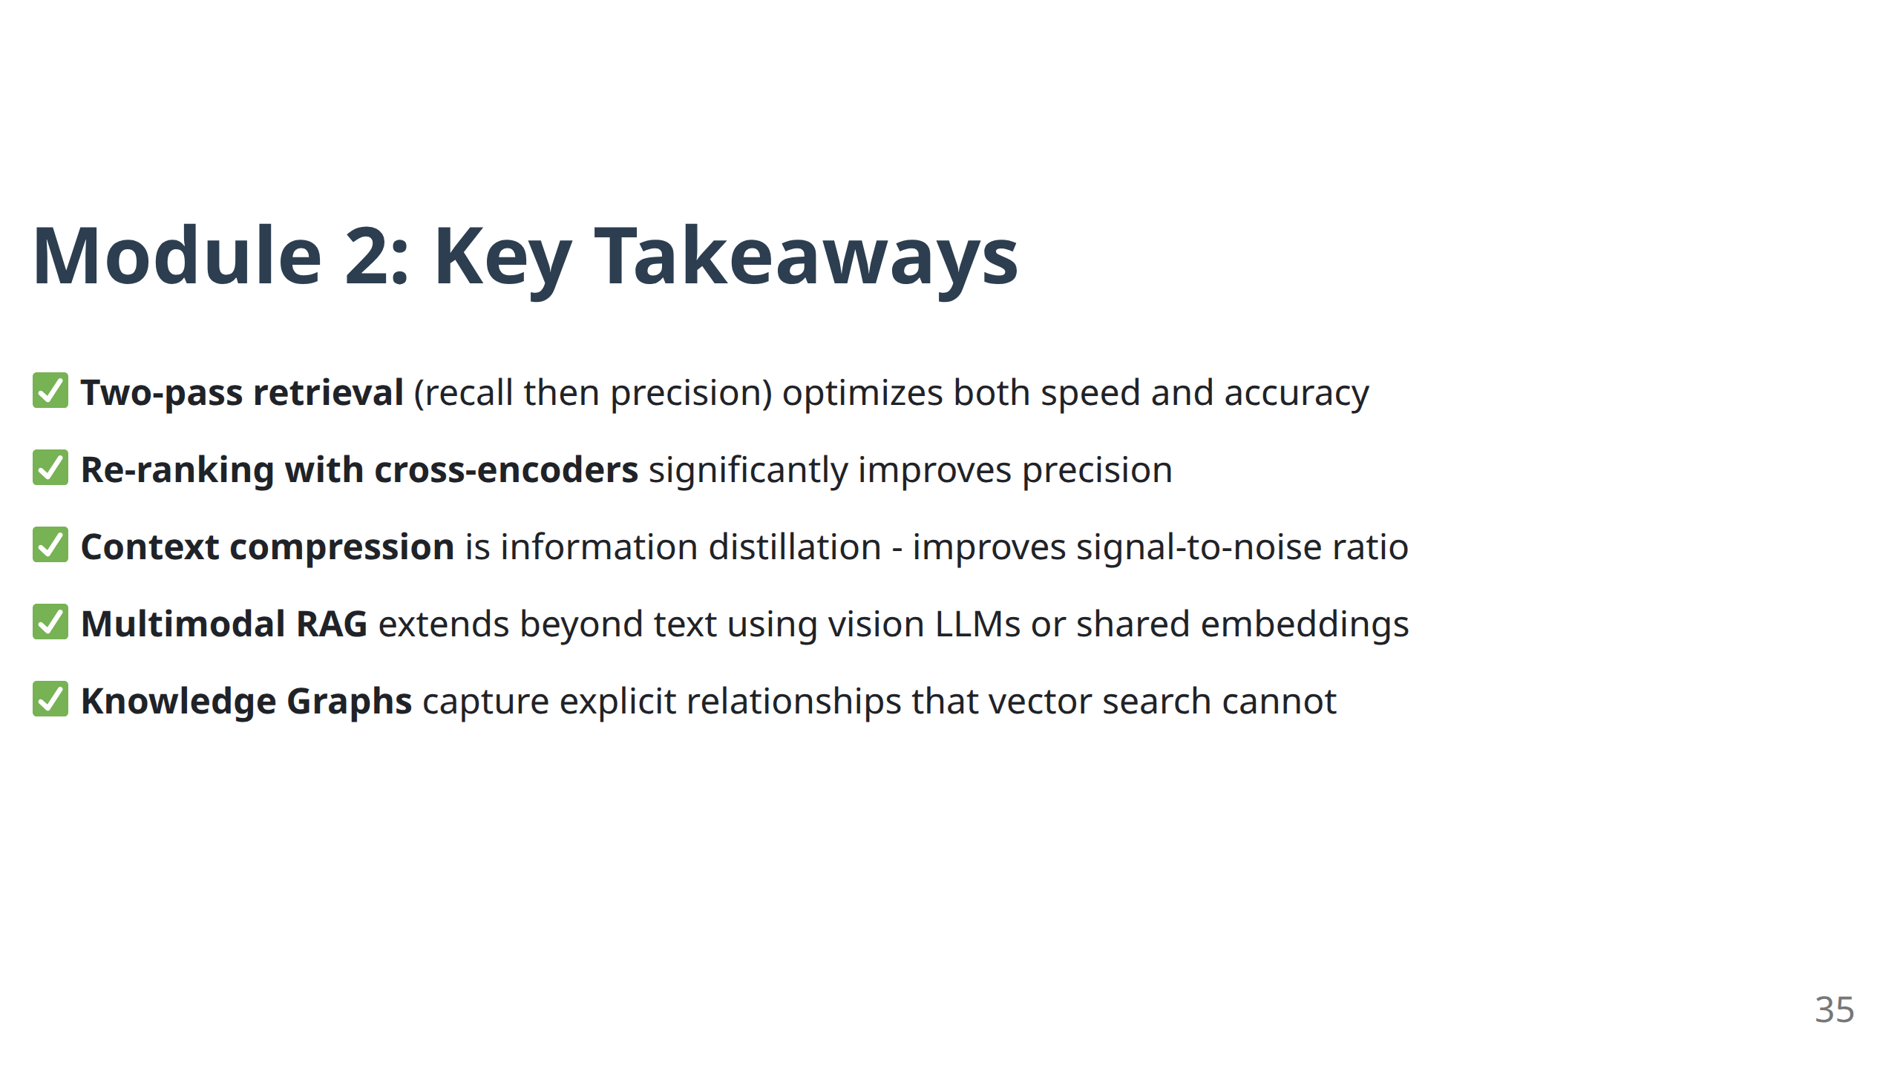

Slide 37

Coffee Break
15 Minutes

Slide 38
Module 3
Advanced Architectures I: GraphRAG & Self-Correcting RAG

Slide 39
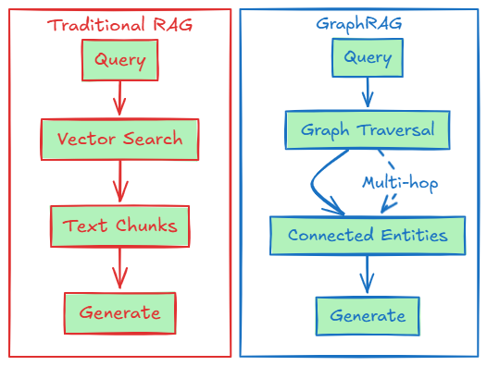
GraphRAG: Merging Connectionist & Symbolic AI
Paradigm Shift: From unstructured text retrieval to structured relationship reasoning
Key Capability: Multi-hop reasoning across explicit relationships
38

Slide 40
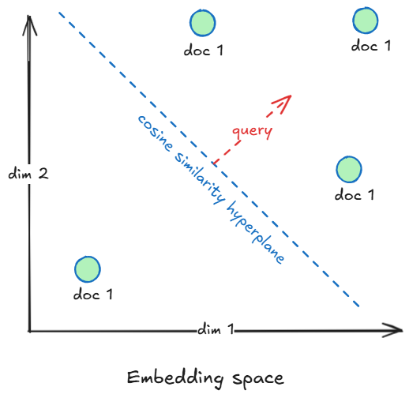
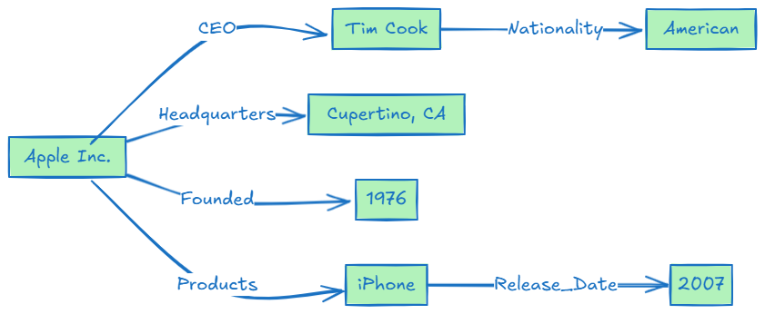
Knowledge Graph Structure
Components:
Nodes: Entities (people, places, concepts, products)
Edges: Relationships (works_for, located_in, caused_by)
Properties: Attributes (name, date, description)
Query Example: "What products are made by the company Tim Cook leads?"
Multi-hop: Tim Cook → CEO → Apple Inc. → Products → iPhone
39

Slide 41
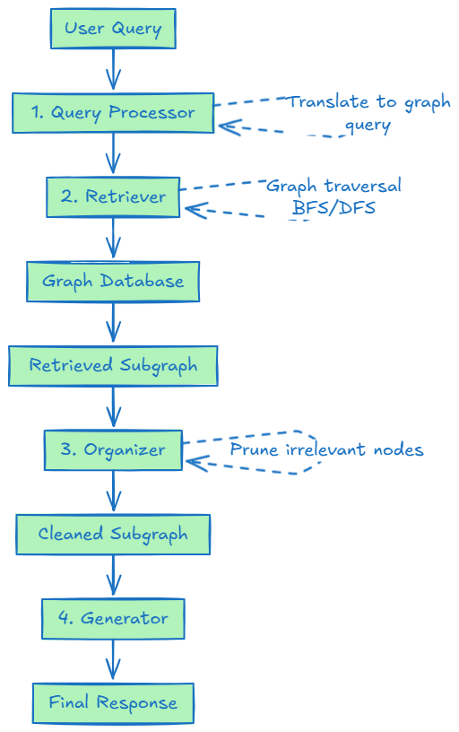
GraphRAG Architecture: Four Components
40

Slide 42
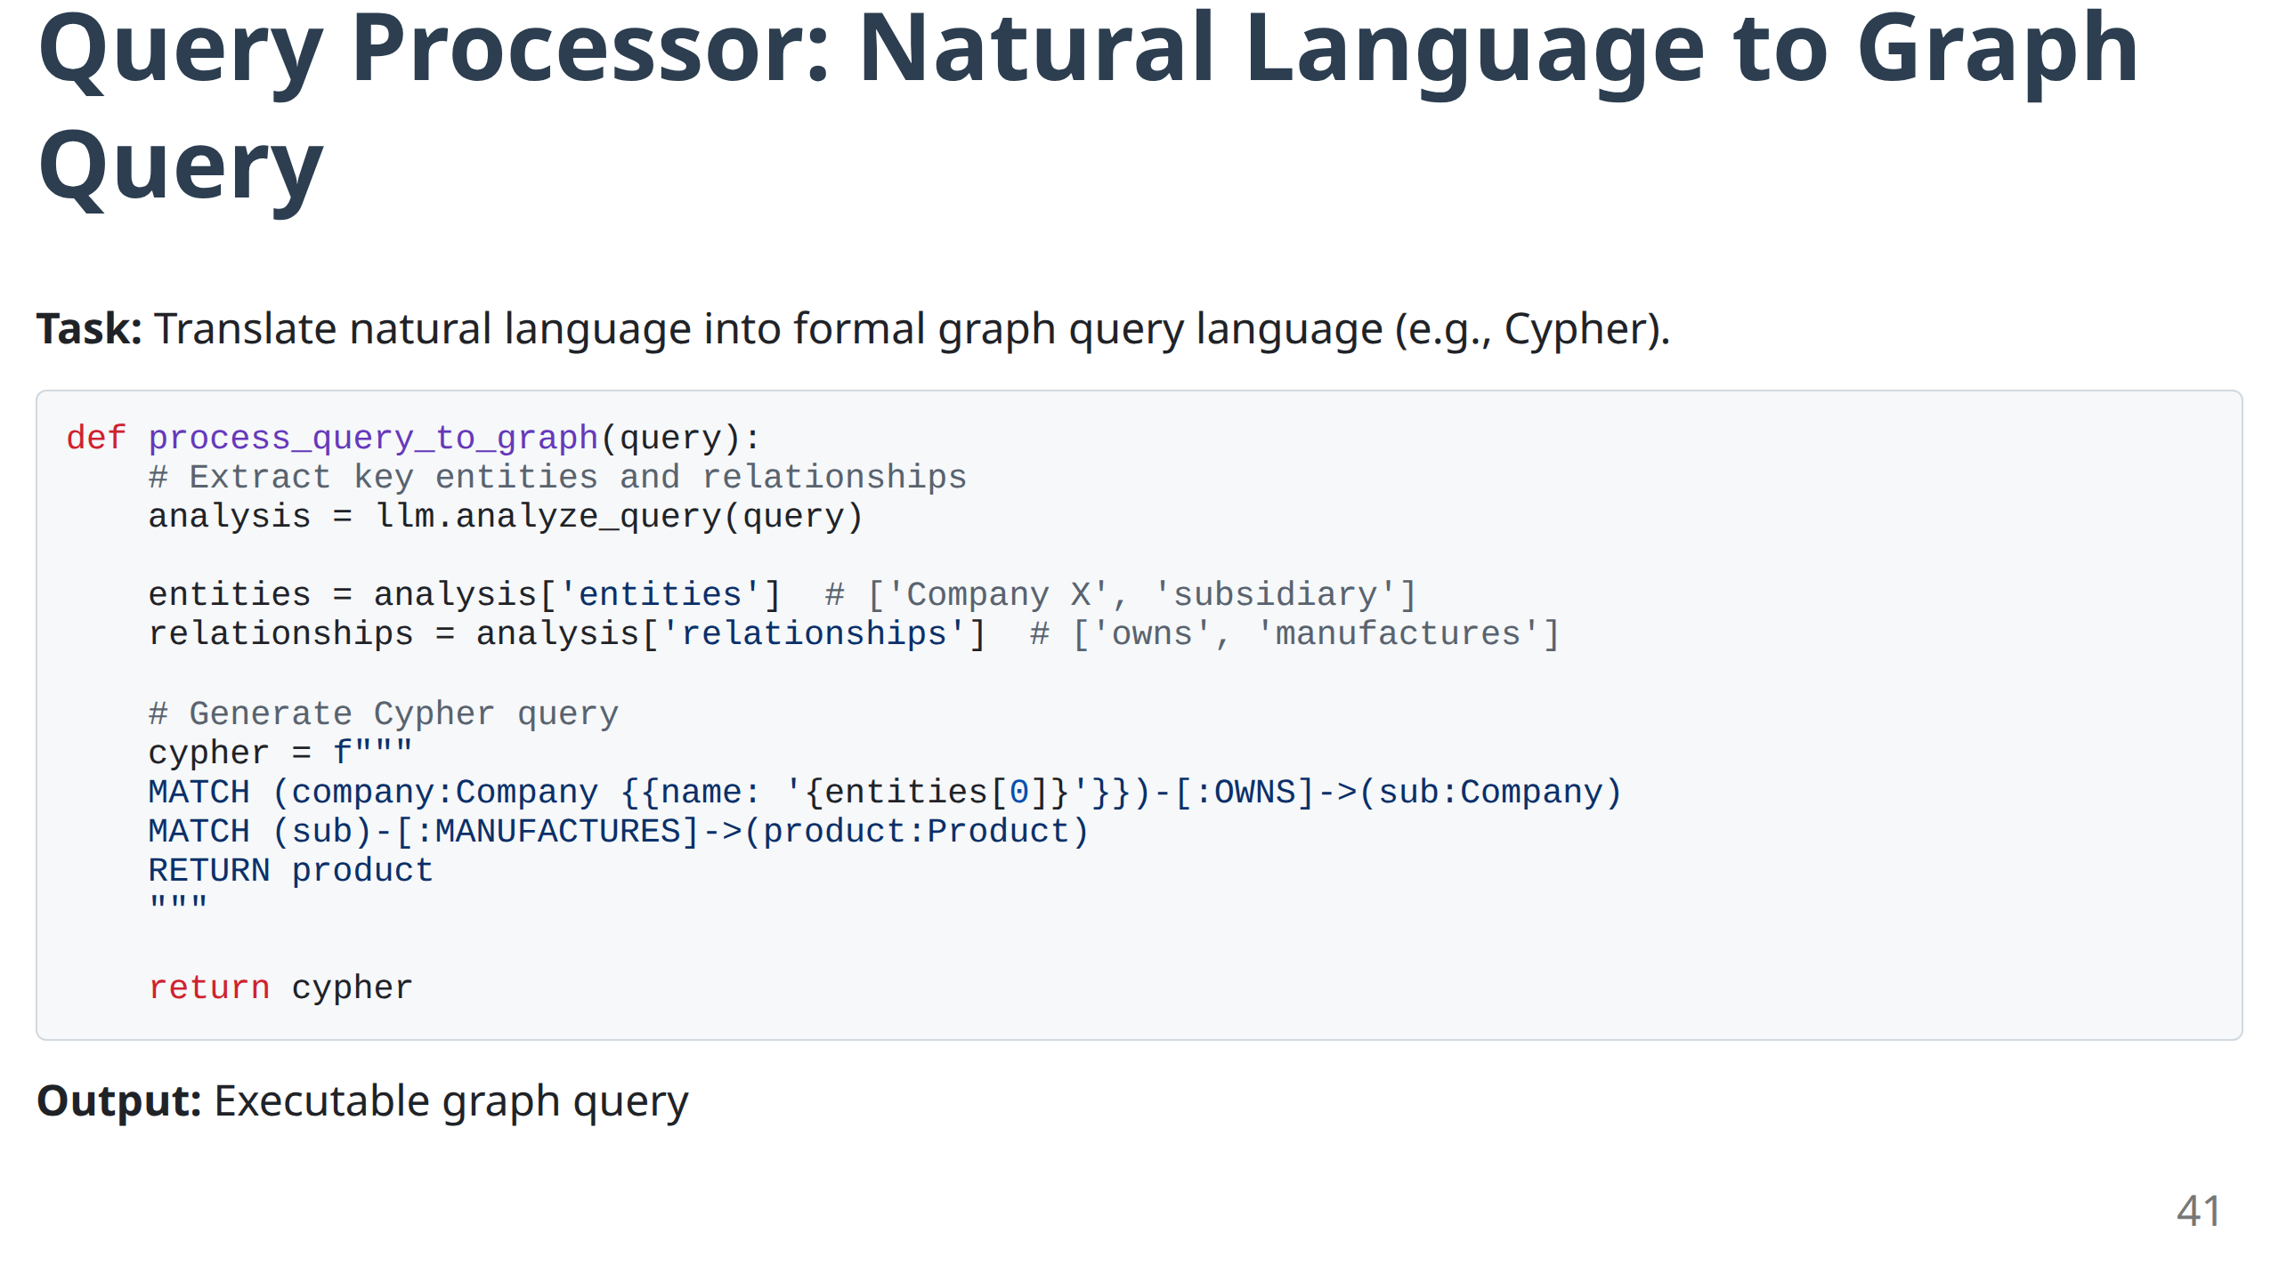

Slide 43
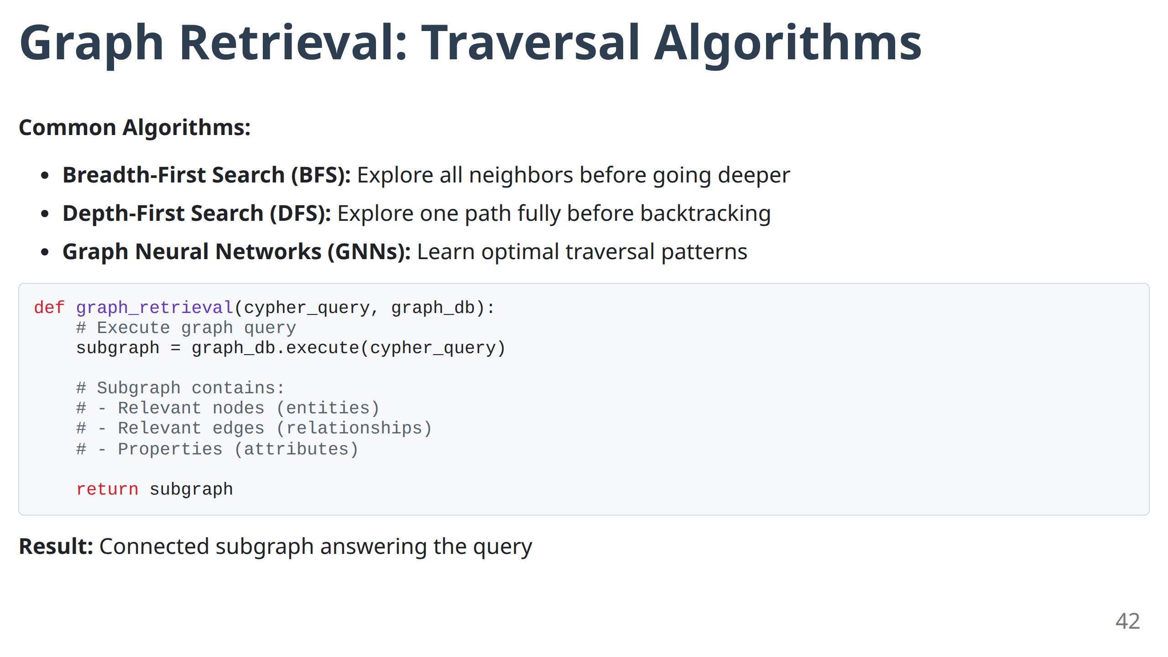

Slide 44
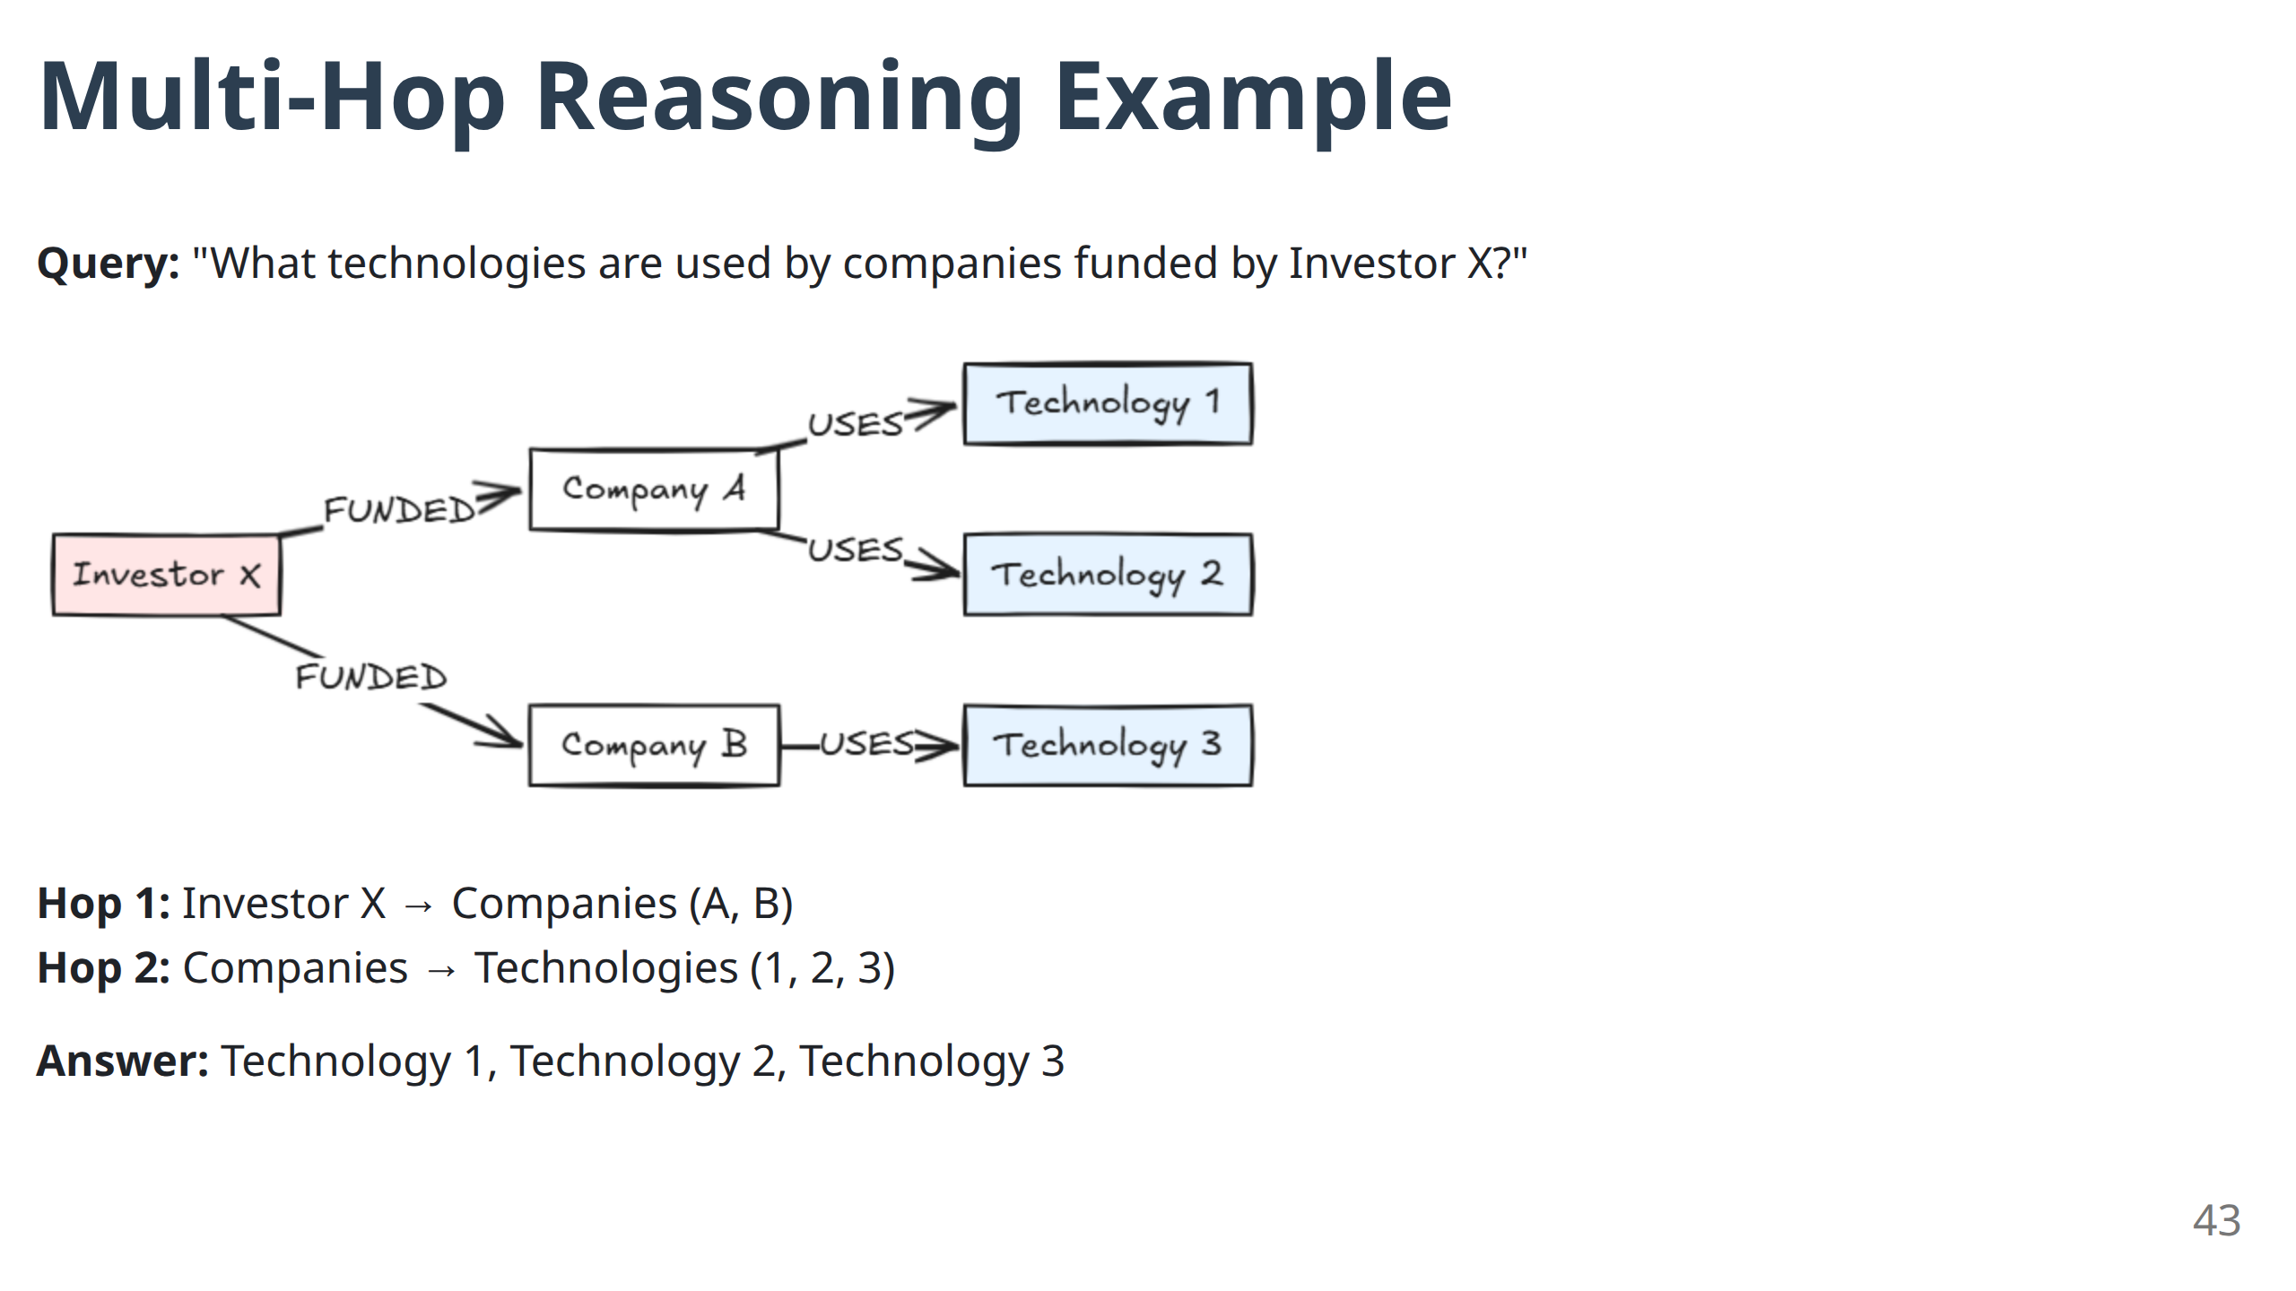
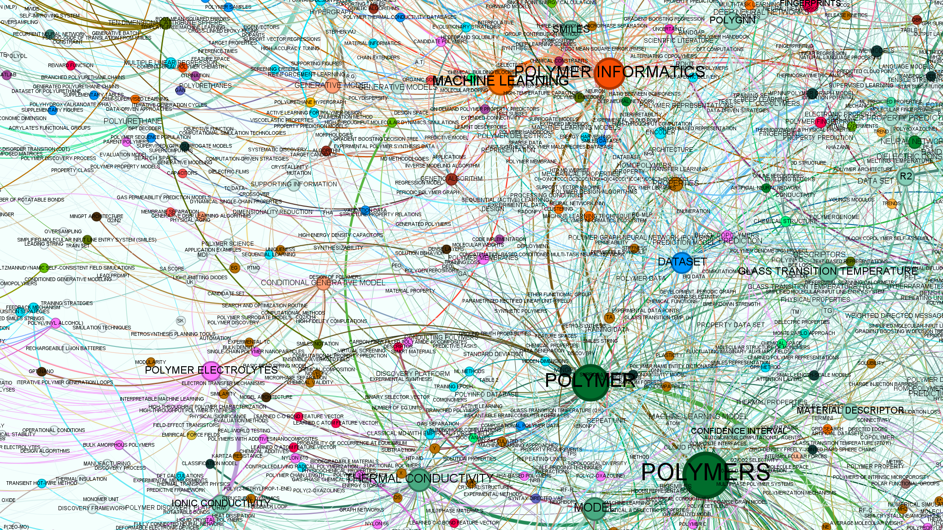

Slide 45
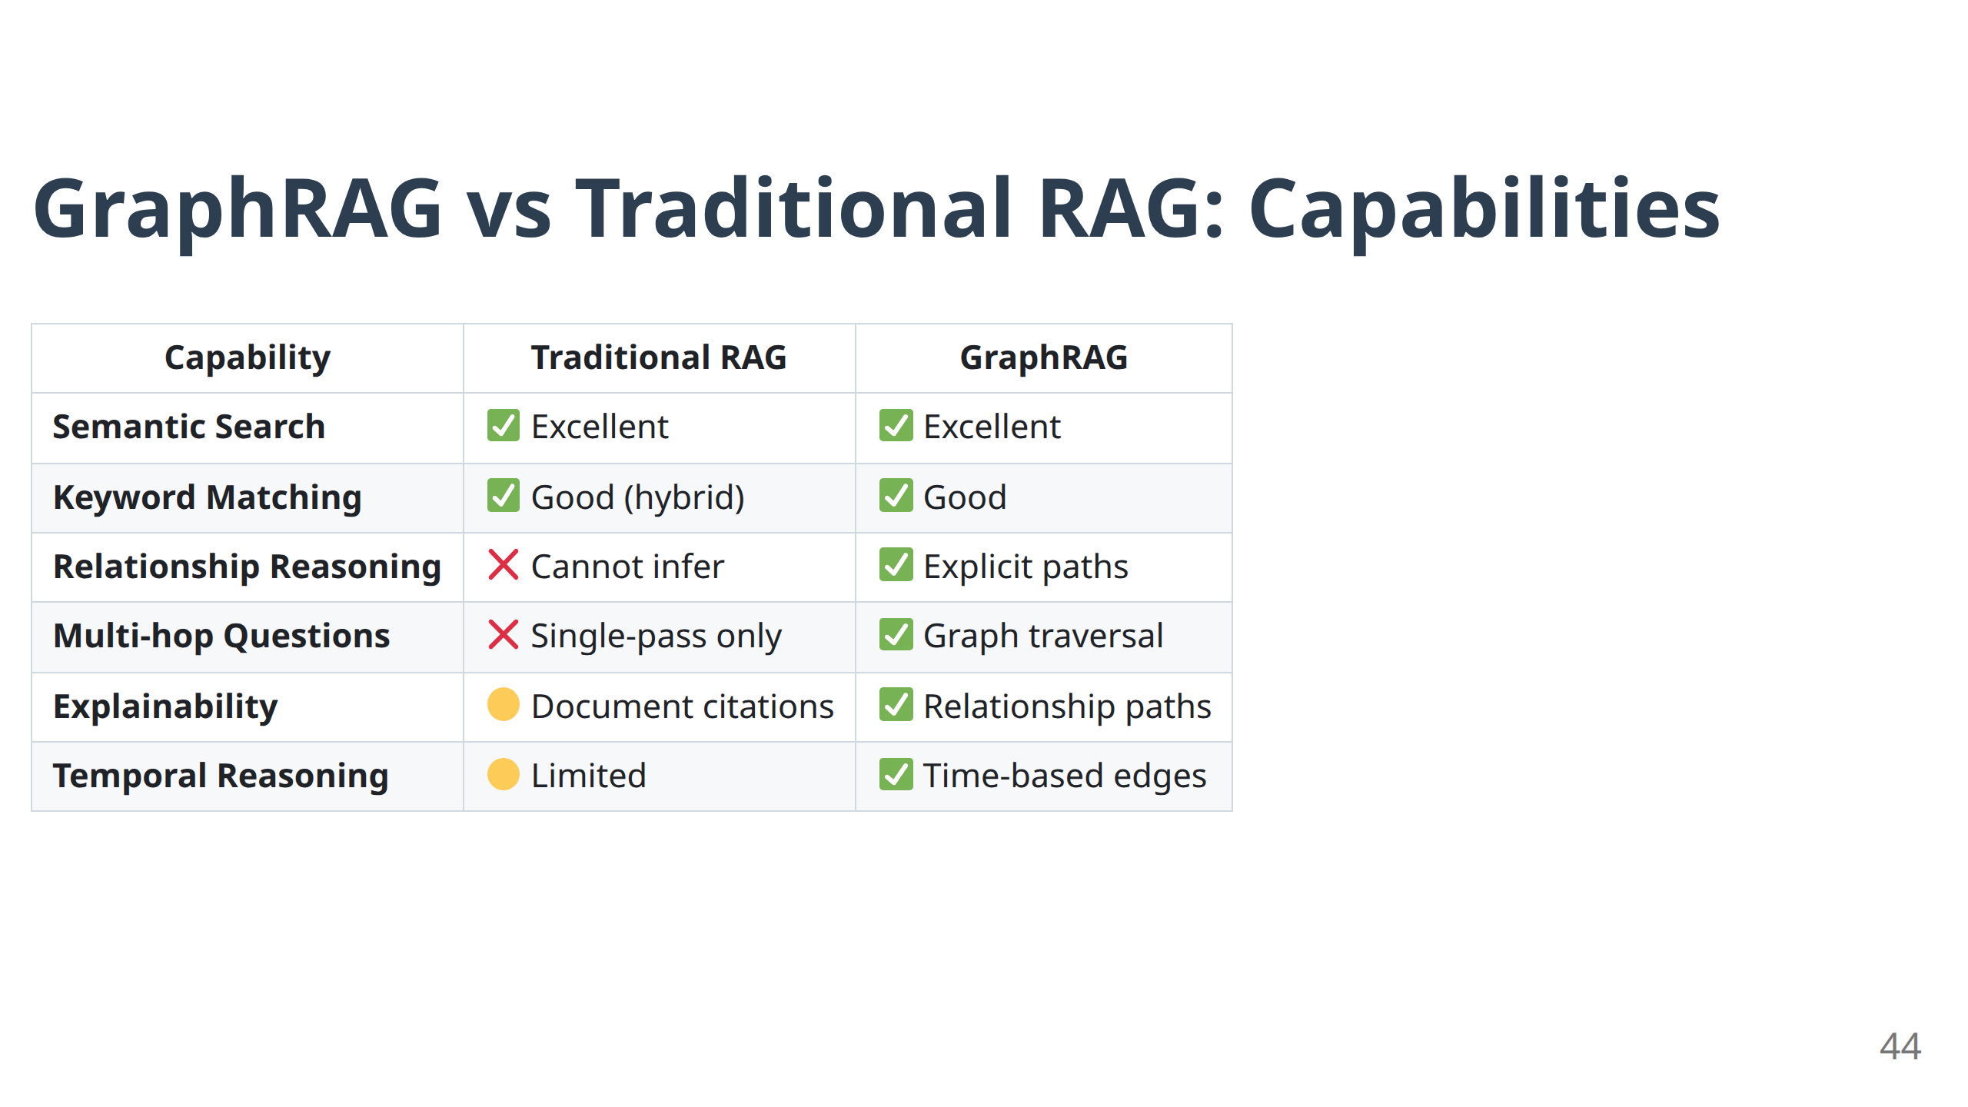

Slide 46
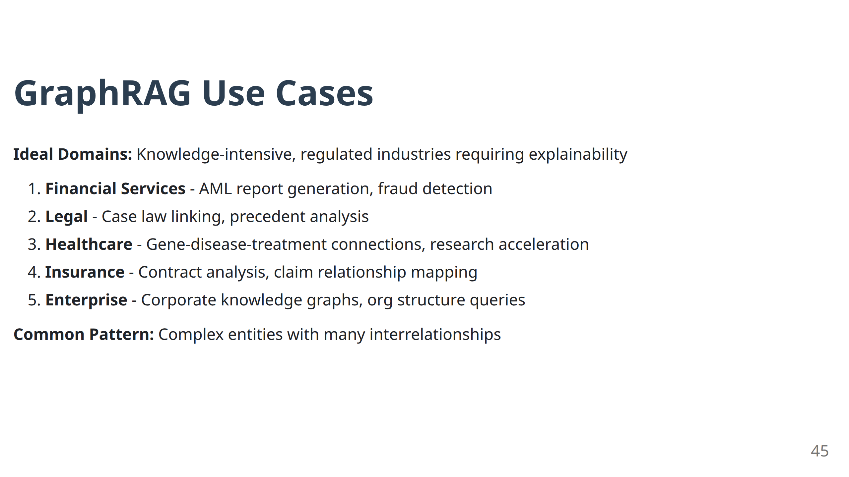

Slide 47
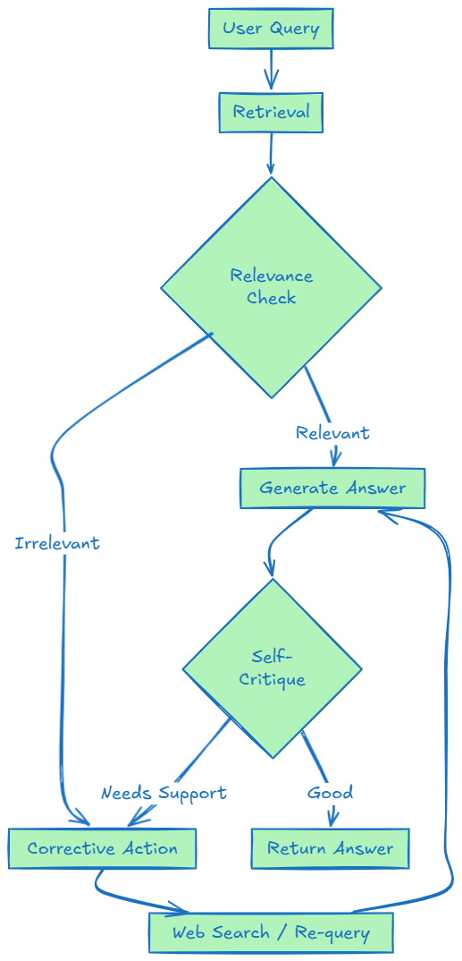
Self-Correcting RAG: The Reflection Pattern
Limitation of Basic RAG:
No quality control - bad retrieval = bad answer
Solution: Add self-evaluation and corrective loops
Key Patterns: Self-RAG, Corrective RAG (CRAG)
46

Slide 48
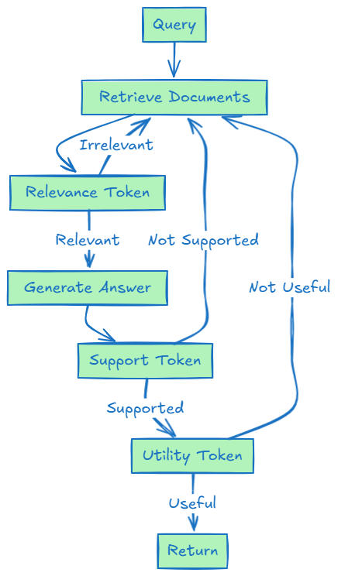
Self-RAG Architecture
Innovation: LLM generates "reflection tokens" to self-assess at each step.
Reflection Tokens:
Relevance: Is the document relevant to the query?
Support: Is the answer supported by the document?
Utility: Is the answer useful to the user?
47

Slide 49
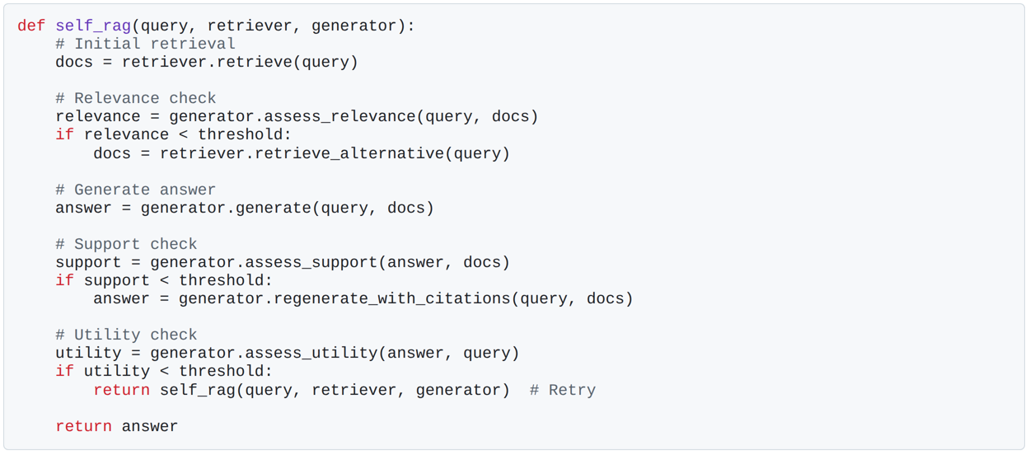
Self-RAG: Reflection Token Generation
48

Slide 50
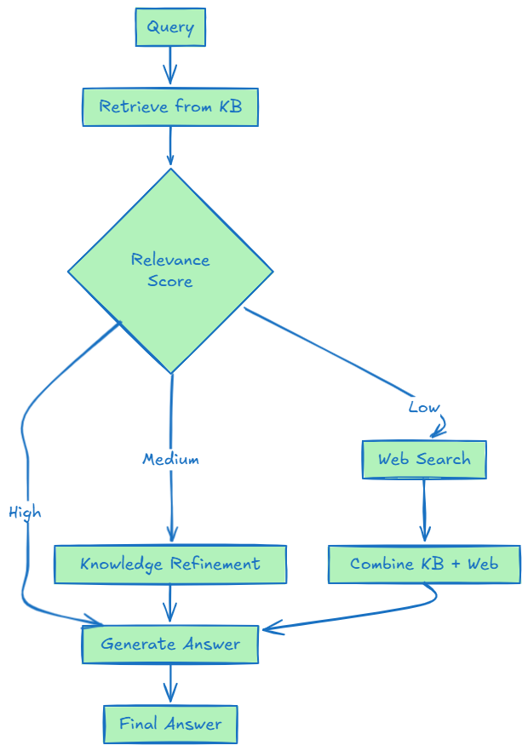
Corrective RAG (CRAG): External Fallback
Innovation: Detect poor retrieval and trigger web search as fallback.
Threshold-Based Routing:
High confidence: Use internal KB
Medium confidence: Refine/decompress KB results
Low confidence: Fallback to web search
49

Slide 51
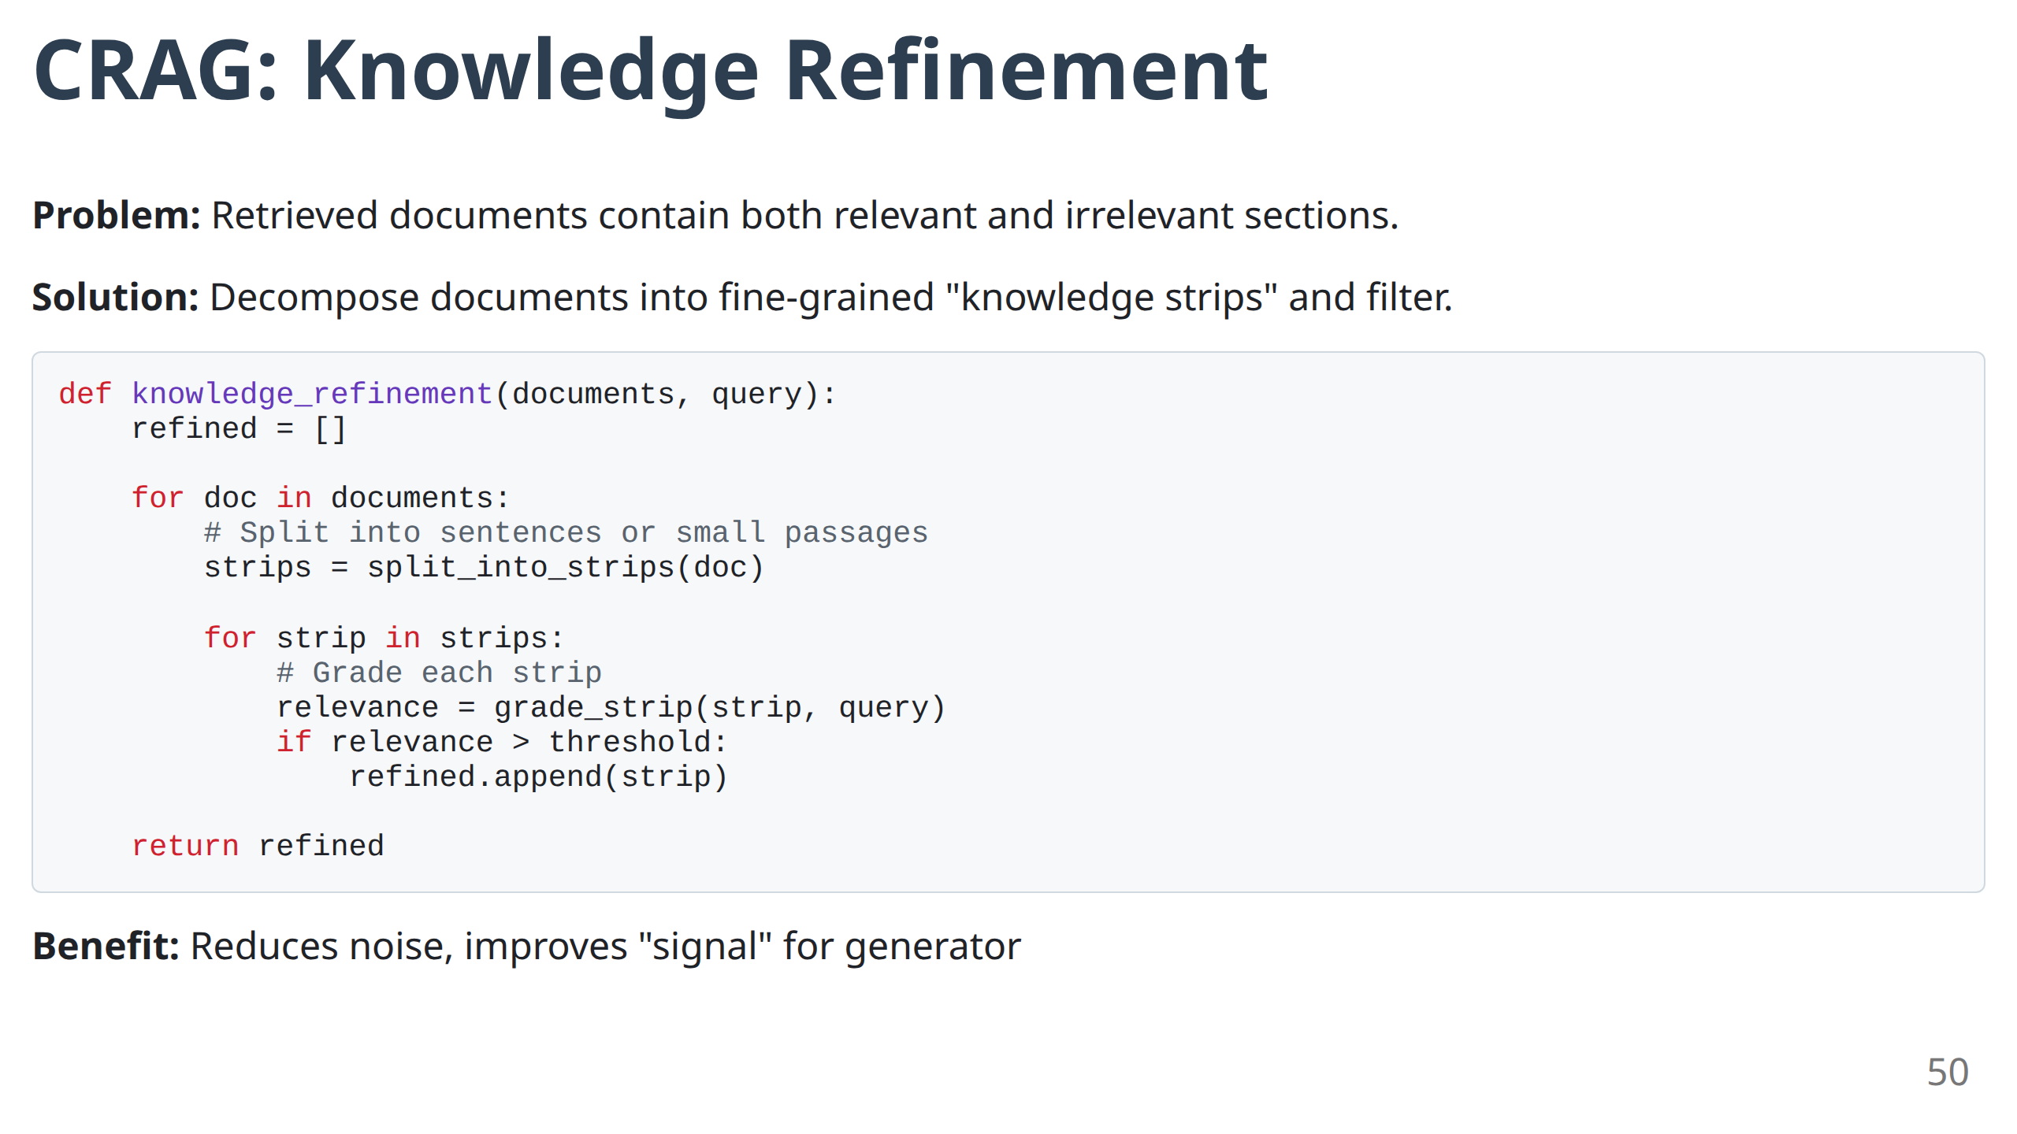

Slide 52
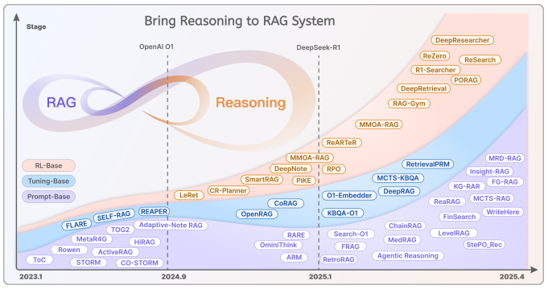
RAG-reasoning
Source: https://arxiv.org/pdf/2504.15909
51

Slide 53
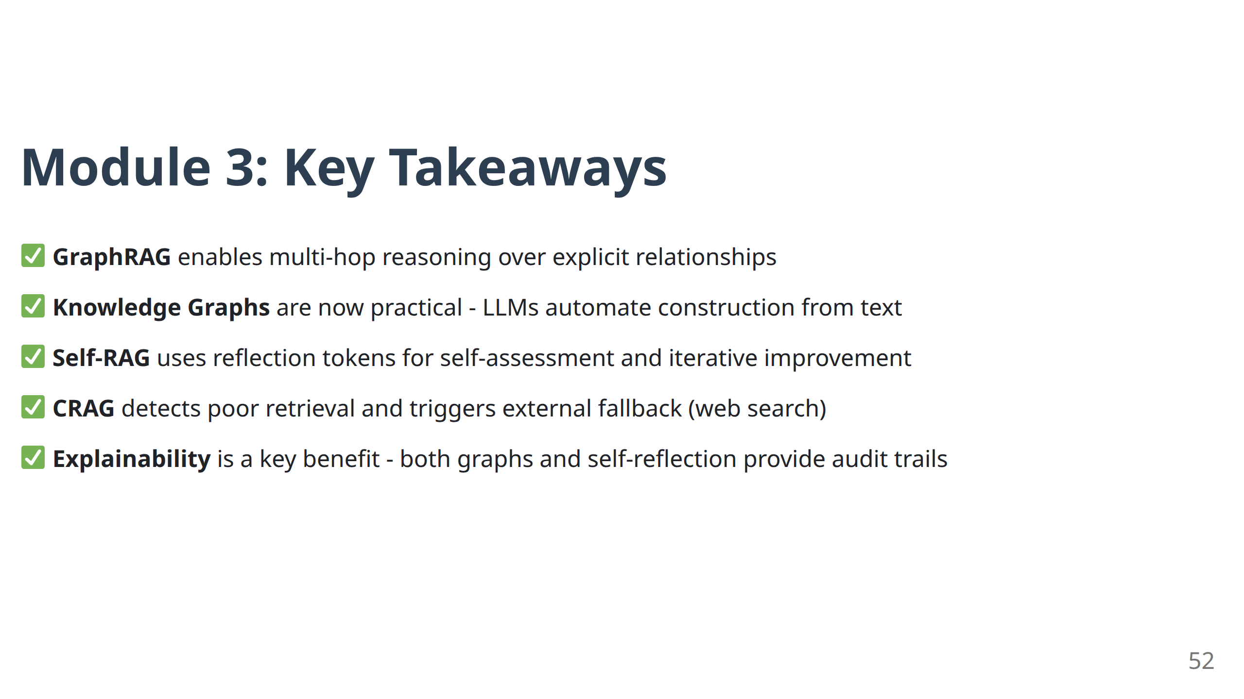

Slide 54
Module 4
Advanced Architectures II: Agentic & Deep Research RAG

Slide 55
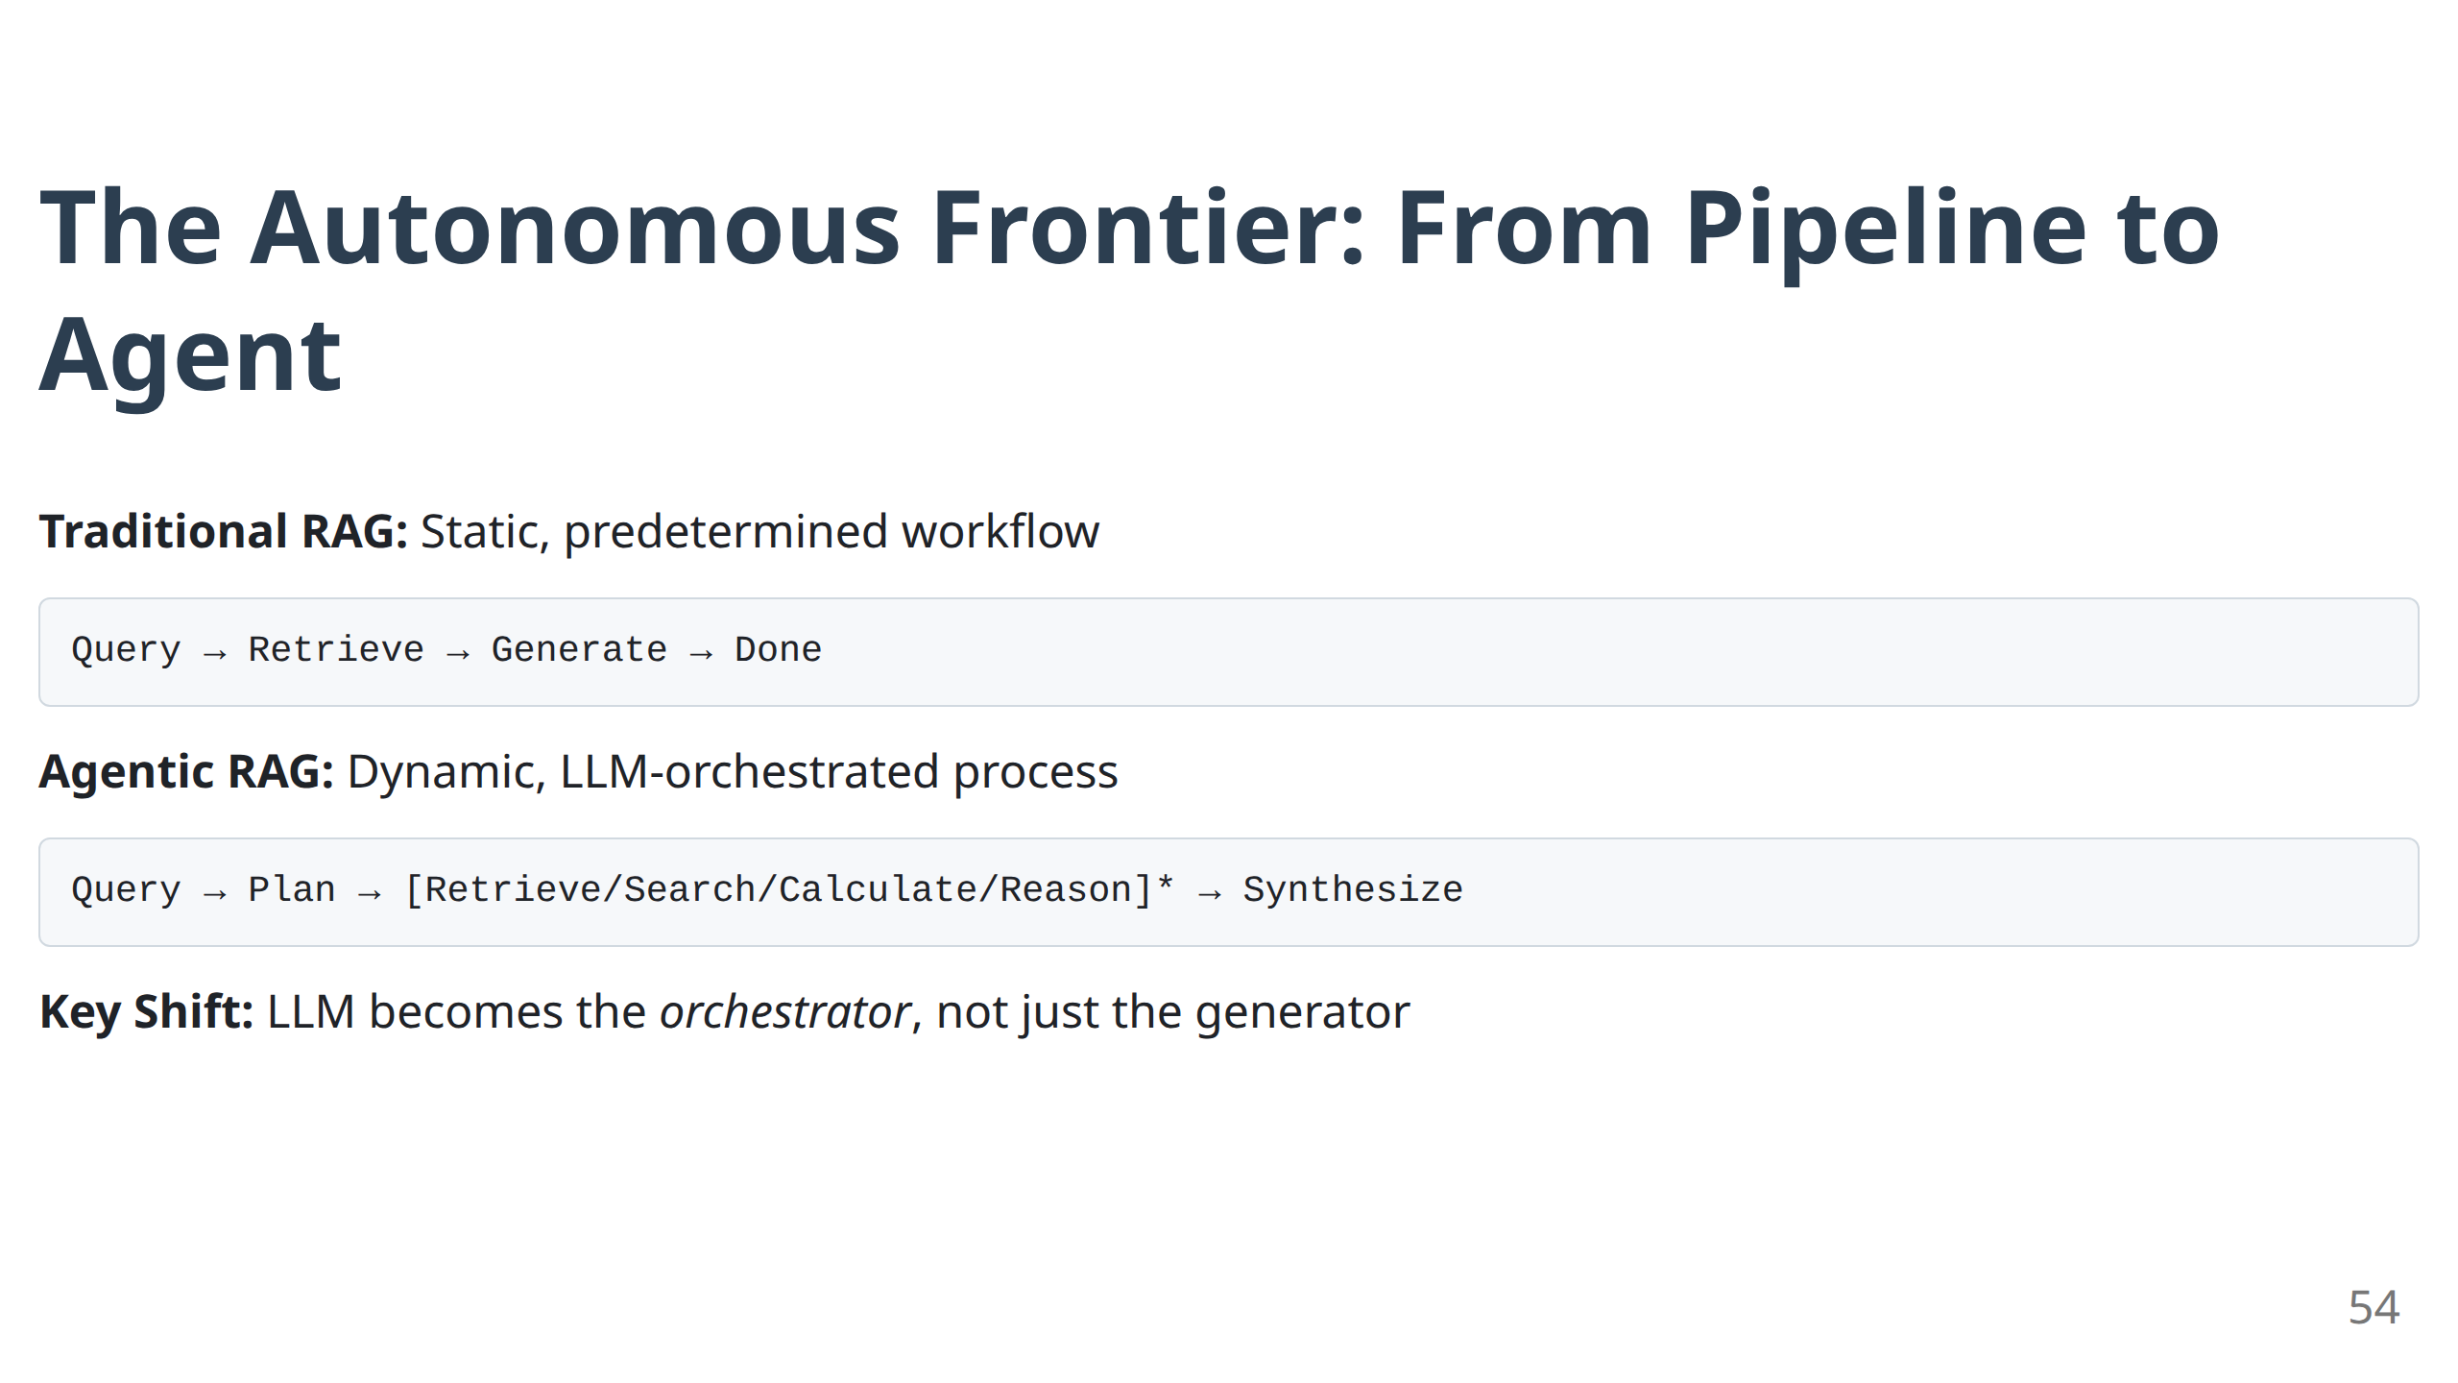

Slide 56

What is an AI Agent?
Definition: An LLM-powered system that can:
Plan - Decompose complex tasks into steps
Act - Execute actions using tools (APIs, search, code)
Observe - Examine results of actions
Reason - Decide next action based on observations
Remember - Maintain context across interactions
55

Slide 57

The ReAct Pattern: Reason + Act
Core Idea: Interleave reasoning traces with action execution.
56

Slide 58


Slide 59

Agentic RAG Patterns: Routing
Problem: Enterprise data is fragmented across multiple sources.
Solution: Routing agent dispatches query to appropriate data source(s).
58

Slide 60


Slide 61

Agentic RAG Patterns: Query Planning
Problem: Complex queries require decomposition into sub-tasks.
Example: "Compare the revenue growth of Apple and Microsoft over the last 5 years"
→ Sub-queries: Apple revenue 5Y, Microsoft revenue 5Y, calculate growth rates, compare
60

Slide 62


Slide 63

Deep Research RAG: Iterative Reasoning
Problem: Some questions cannot be answered in a single retrieval pass.
Solution: Agent iteratively deepens understanding through multiple rounds.
Use Case: Literature review, competitive analysis, market research
62

Slide 64

Deep Research Agent: Implementation
63

Slide 65

LangGraph: Framework for Agentic Workflows
Challenge: Implementing complex agent control flows is difficult.
Solution: LangGraph provides state machines for agent orchestration.
64

Slide 66

LangGraph: State Management
Benefits:
Explicit state transitions
Conditional branching
Cycle support (for iterations)
Debugging and observability
65

Slide 67

Agentic RAG: Multi-Agent Systems
Advanced Pattern: Multiple specialized agents collaborate.
Example Roles:
Retrieval Agent: Finds relevant information
Analysis Agent: Performs calculations, data analysis
Synthesis Agent: Combines findings into coherent report
66

Slide 68


Slide 69


Slide 70


Slide 71
Module 5
Production-Ready RAG: Evaluation & Best Practices

Slide 72


Slide 73


Slide 74
Retrieval Metrics: Context Precision & Recall
Context Precision: What % of retrieved chunks are actually relevant?
Precision = (# Relevant Retrieved) / (# Total Retrieved)
Context Recall: What % of relevant chunks were retrieved?
Recall = (# Relevant Retrieved) / (# Total Relevant in Corpus)
Trade-off: Higher recall (retrieve more) vs. higher precision (retrieve less but better)
73

Slide 75

Generation Metrics: Faithfulness
Definition: Is the generated answer factually grounded in the retrieved context?
Assessment Method:
Extract claims from the generated answer
For each claim, verify if it's supported by the context
Calculate % of supported claims
Target: > 0.9 (90% of claims should be grounded)
74

Slide 76

Generation Metrics: Answer Relevance
Definition: How well does the answer address the user's query?
Assessment Method:
Use LLM to generate expected questions that this answer would address
Compare generated questions to original query
Calculate semantic similarity
Target: > 0.8 (high alignment with user intent)
75

Slide 77


Slide 78

RAGAS: Metrics Suite
Core Metrics Provided:
Context Precision - Retrieval quality
Context Recall - Retrieval completeness
Faithfulness - Grounding in context
Answer Relevance - Alignment with query
Context Entity Recall - Entity coverage
Answer Semantic Similarity - Comparison to ground truth
77

Slide 79

Building an Evaluation Dataset
Challenge: Need ground truth data to evaluate against.
Approaches:
Human-Annotated: Gold standard but expensive
Synthetic Generation: Use LLMs to generate query-answer pairs
Production Logs: Real user queries with expert-reviewed answers
78

Slide 80
Common RAG Failure Modes
1. Retrieval Failures:
Low precision (irrelevant chunks retrieved)
Low recall (relevant chunks missed)
Poor chunking (semantically incoherent)
2. Generation Failures:
Hallucination (not grounded in context)
Irrelevant answers (doesn't address query)
Lost in the middle (ignores mid-context info)
3. System Failures:
High latency (too slow for users)
Inconsistent results (non-deterministic)
Scalability issues (can't handle load)
79

Slide 81

Debugging RAG Systems: Systematic Approach
80

Slide 82


Slide 83
Production Best Practices: Monitoring
Key Metrics to Track:
Latency:
P50, P95, P99 response times
Per-component latency breakdown
Quality:
Sampled faithfulness scores
User feedback (thumbs up/down)
Answer quality drift over time
Cost:
LLM API costs per query
Vector DB compute costs
Total cost per user
Usage:
Query volume and patterns
Failure rate
Retry rate
82

Slide 84


Slide 85


Slide 86
Production Best Practices: Security & Privacy
Key Considerations:
Data Access Control
Ensure users only retrieve authorized documents
Implement row-level security in vector DB
PII Protection
Detect and redact sensitive information
Compliance with GDPR, HIPAA, etc.
Prompt Injection Defense
Sanitize user inputs
Monitor for adversarial queries
Output Filtering
Content safety checks
Toxicity detection
85

Slide 87


Slide 88


Slide 89
Workshop Wrap-Up

Slide 90


Slide 91


Slide 92


Slide 93


Slide 94


Slide 95


Slide 96
Happy Building! 🚀
Remember: Start simple, measure everything, iterate based on data.

